Slide 1
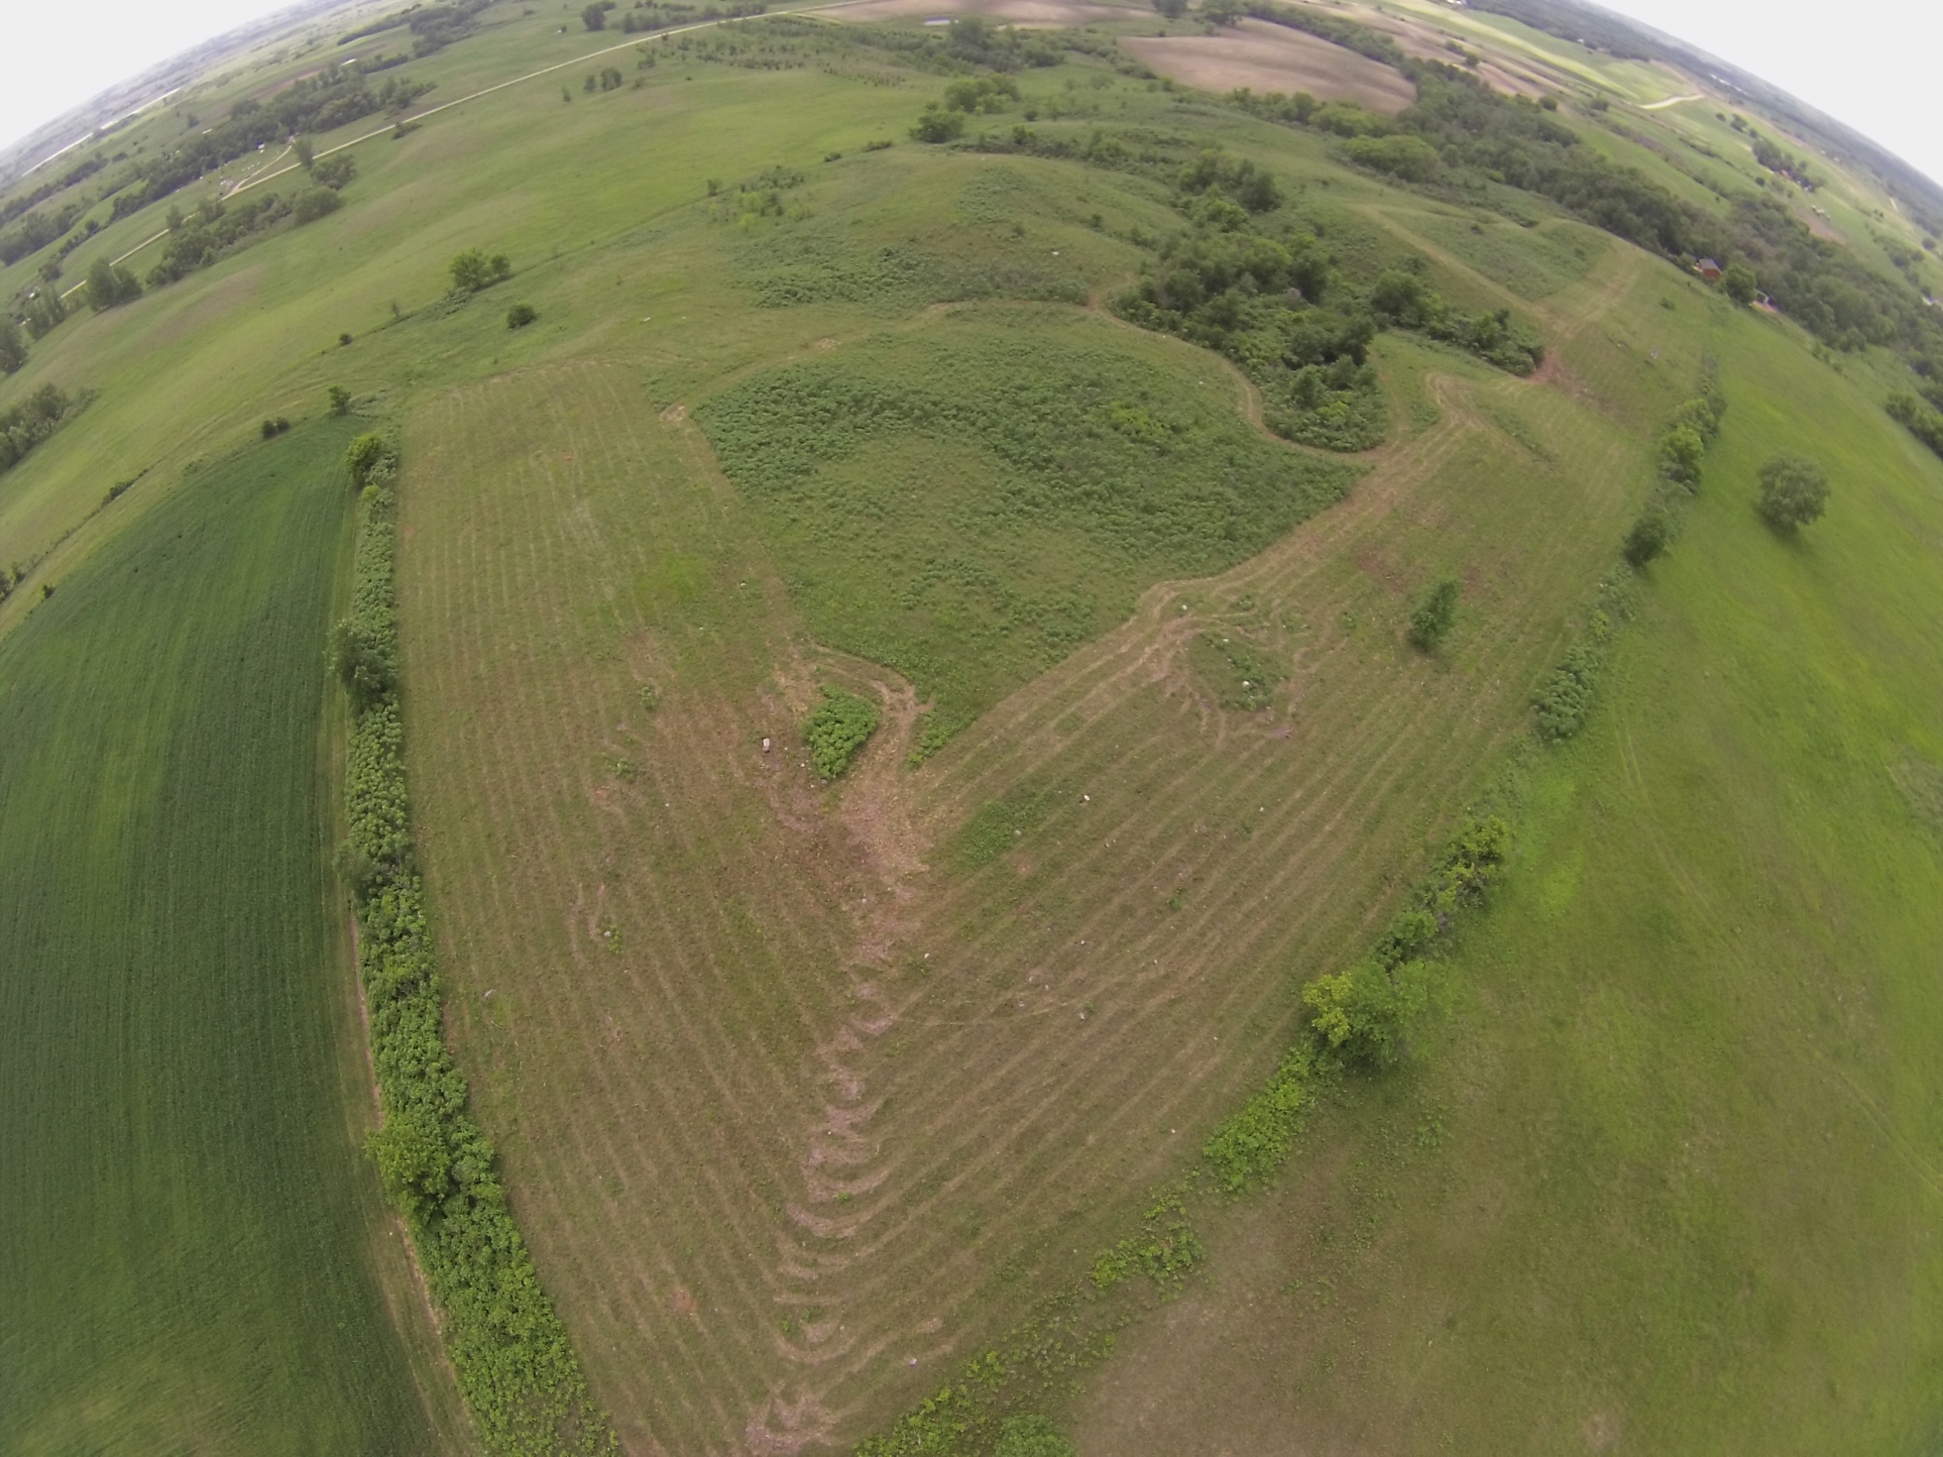
Slide source:
Andy Marcum

