Slide 1
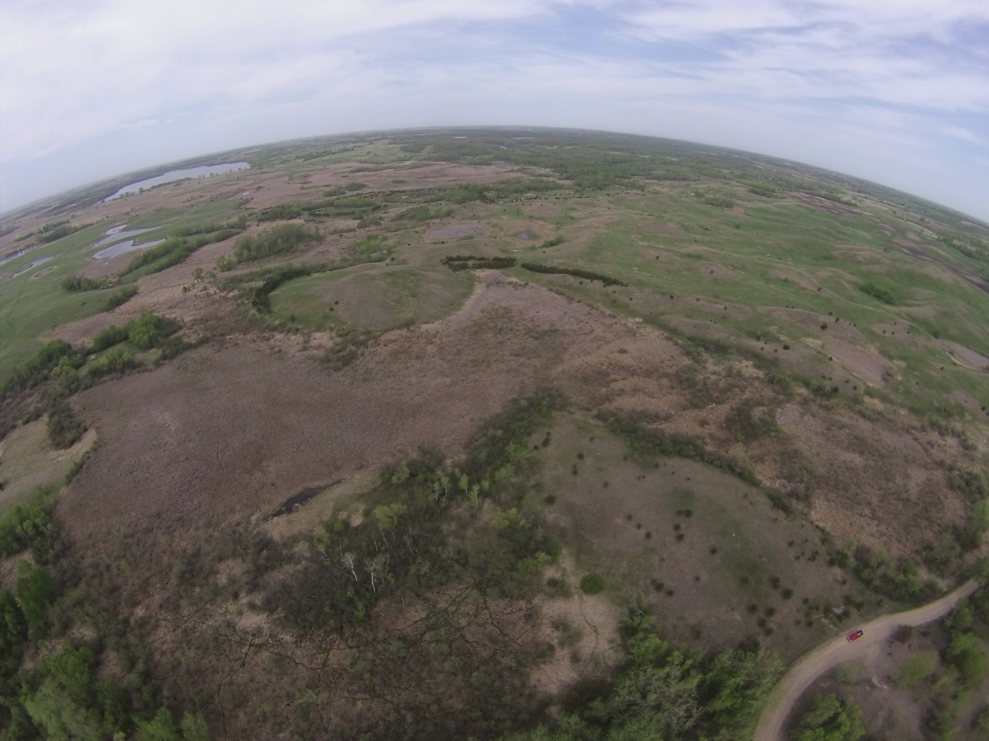
Simon Lake Challenge Community Based Conservation
Slide source: Andy Marcum

