Slide 1
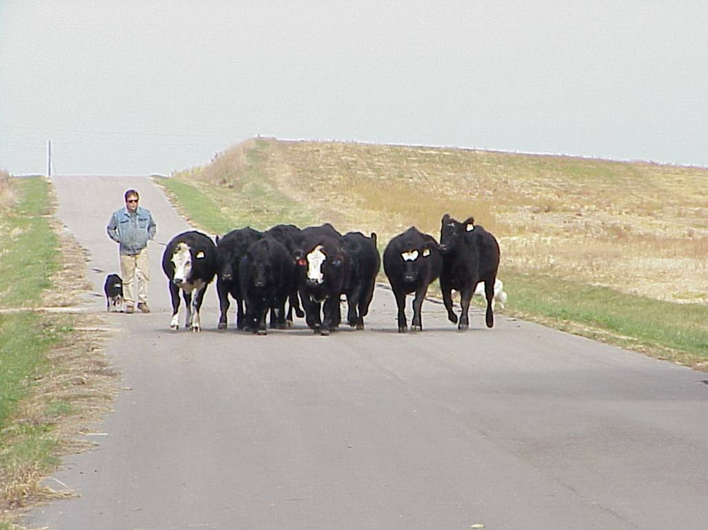
Goal: Have the right animals at the right place at the right time for the right reasons
Slide source: Laura Paine

