Slide 1
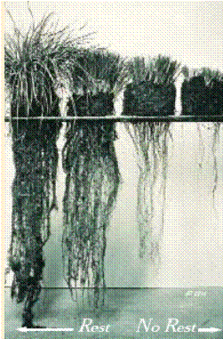
Over Grazed
Well Rested
Slide Source: Laura Paine
Notes:
The great thing about managed grazing is that the same practices that result in better productivity also result in improved environmental performance. The rest rotation cycle is key to both. As you increase the rest period, the grass plant’s root system has a chance to regrow as well, restoring energy reserves and helping hold the soil in place.
This slide shows well rested grass plants on the left and overgrazed plants on the right that have not had enough rest. The plants on the left have much more stored energy in the roots. Their roots go deeper into the soil, allowing them to access water and nutrients that are not available to the overgrazed plants.

