Slide 1
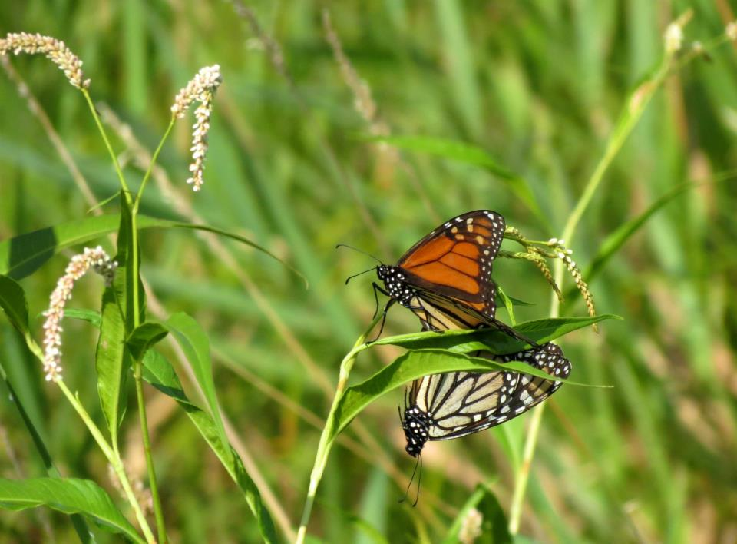
1-1 Conversations
Their History?
Farm History?
What are they proud of?
What they would like to see on their farm?
Changes in the community?
Conservation Goals?
Stating these values provides us with an opportunity to support action.
Andy Marcum

