Slide 2
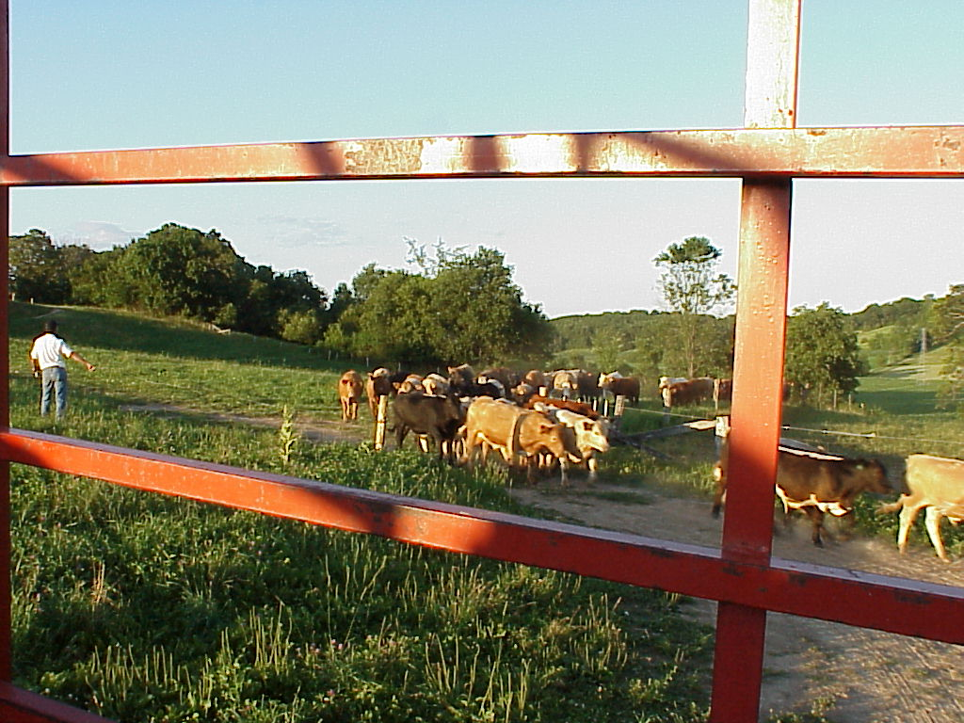
The nuts and bolts of Grazing for Conservation and Soil Health
Laura Paine
Program Director
Dairy Grazing Apprenticeship
608-338-9039
lkpaine@gmail.com
GLBW Grazing Educators Webinar
September 11, 2015
Notes:
Intro slide: We’ve talked about the basics of working with non-farming landowners and how to engage with our audience. Now we will turn to some details of how to manage grazing to achieve conservation results.

