Slide 1
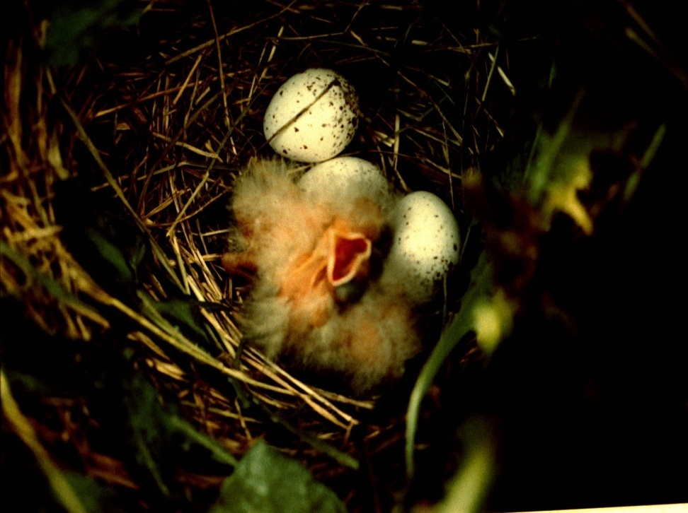
Making Compromises: Nest Survival
Slide Source: Laura Paine
Notes:
Grazing does present the need for compromise, however. This graph is a compilation of data from several studies. As you can see, rowcrop fields clearly do not provide habitat attractive to grassland birds (or many other wildlife species for that matter). Alfalfa provides appropriate structure, but nest mortality is high because of poorly timed harvests. Rotational pastures and CRP attracted similar numbers of nesting birds, and as you can see, nest mortality is high even in the relatively ‘safe’ CRP habitat. When we looked at rotationally grazed pasture systems, we found that cattle disturbance reduced nest survival, so we set up some nesting refuges within pasture systems. These idled paddocks performed as well as CRP fields in terms of output of fledglings.

