Slide 1
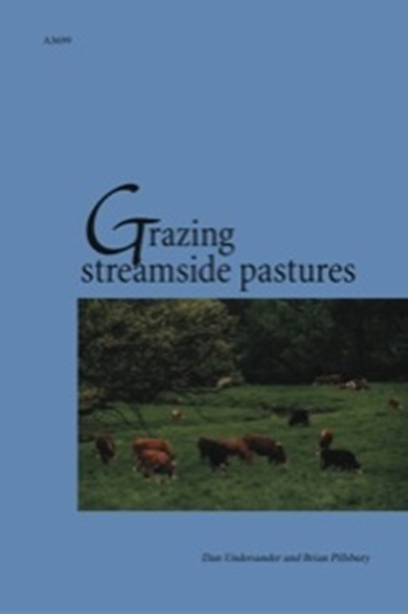
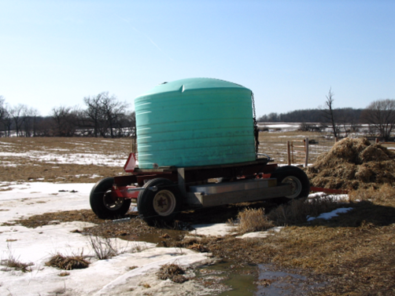
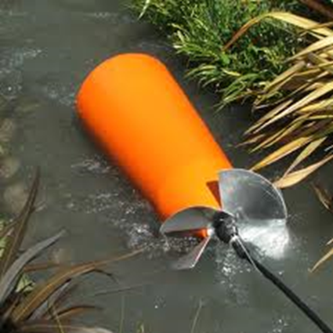
Managing Riparian Pastures
Slide Source: Laura Paine
Notes:
Out of that study came a publication that may be of value to you. It is a UW Extension bulleting available from their publishing arm, the Learning Store. In it we summarize what we learned from producers who have been managing along streams. Two fencing approaches are possible. On the left is one that keeps a section of the stream in each paddock. On the right, the stream is separated in its own paddocks so that those paddocks can be skipped if bank conditions aren’t appropriate. The publication also talks about ways of managing water access, including pumping out of the stream into tanks. We find that often livestock, when given a choice, prefer to drink from a tank and one way of reducing bank damage is to offer an alternative source of water.

