Slide 1
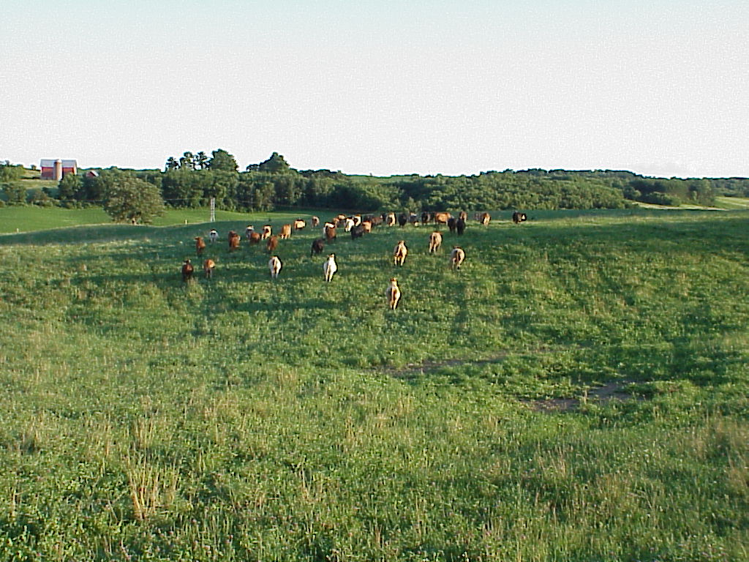
Managing Grazing to Enhance Grassland Bird Habitat
Slide Source: Laura Paine
Skinner, R.M. 1975. Grassland use patterns and prairie bird populations in Missouri. In: M.K. Wali, Ed. Prairie: A multiple view. University of North Dakota Press.
Notes:
Regardless of the species growing in the grassland or pasture, managing it to provide high quality habitat for grassland wildlife is very possible. As noted in the previous slide, the birds of North American grasslands are adapted to grazing. This slide from some Missouri research shows the attraction of grassland birds to the vegetation structure created by grazing. You can see the list of species in the upper right hand corner. Across the x-axis of the graph is vegetation height and what this illustrates is that most of the species select the grazed habitat with shorter more variable structure. There are a few species that prefer tall, dense, idle grasslands as well. The point is that we need to provide habitat across this spectrum in order to have healthy populations of these declining species.

