Slide 1
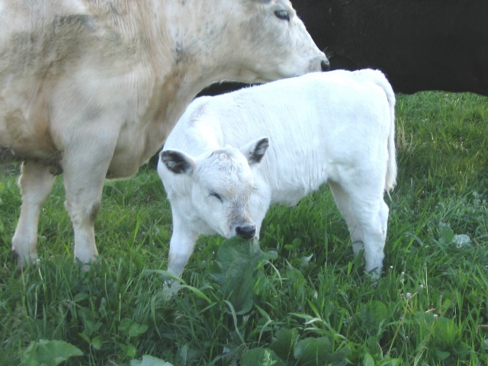
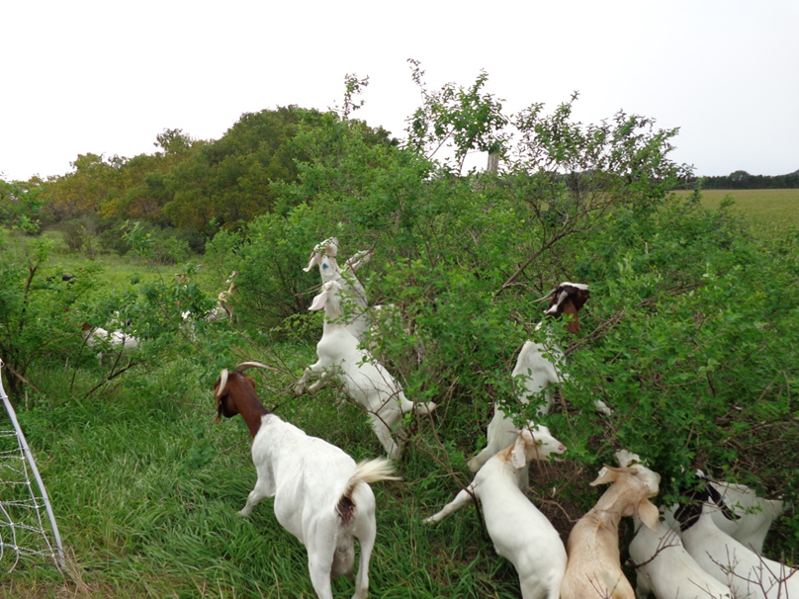
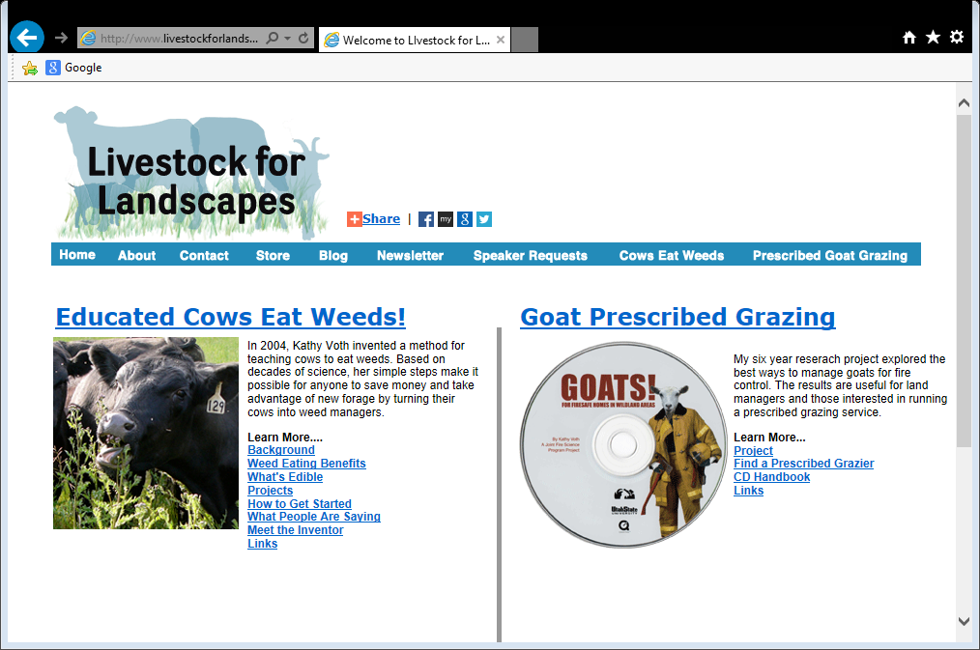
http://www.livestockforlandscapes.com/
Slide source: Laura Paine
Notes:
There is also the potential to train livestock to eat weeds. You may be aware of the growing utilization of goats to reduce weeds and especially brush encroachment. I know of at least three companies in WI alone that ‘rent’ goats for brush control. We can also train other classes of livestock to eat weeds. Kathy Voth, an animal behaviorist from Colorado, has developed a method for training cattle to consume pasture weeds. We used the method to train some of our cows to eat Canada thistles.

