Slide 1
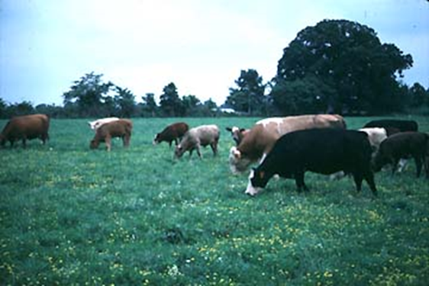
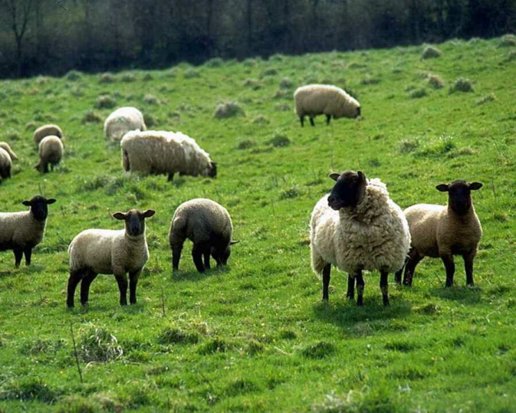
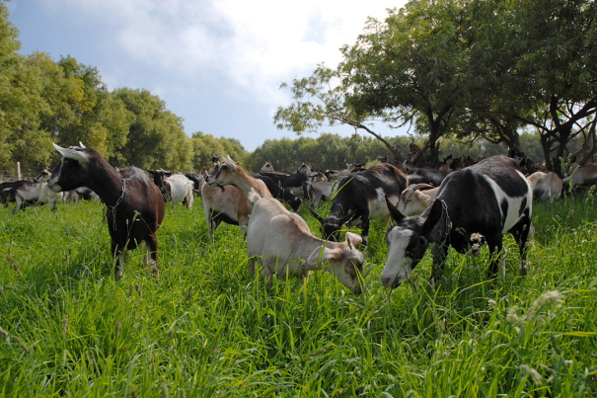
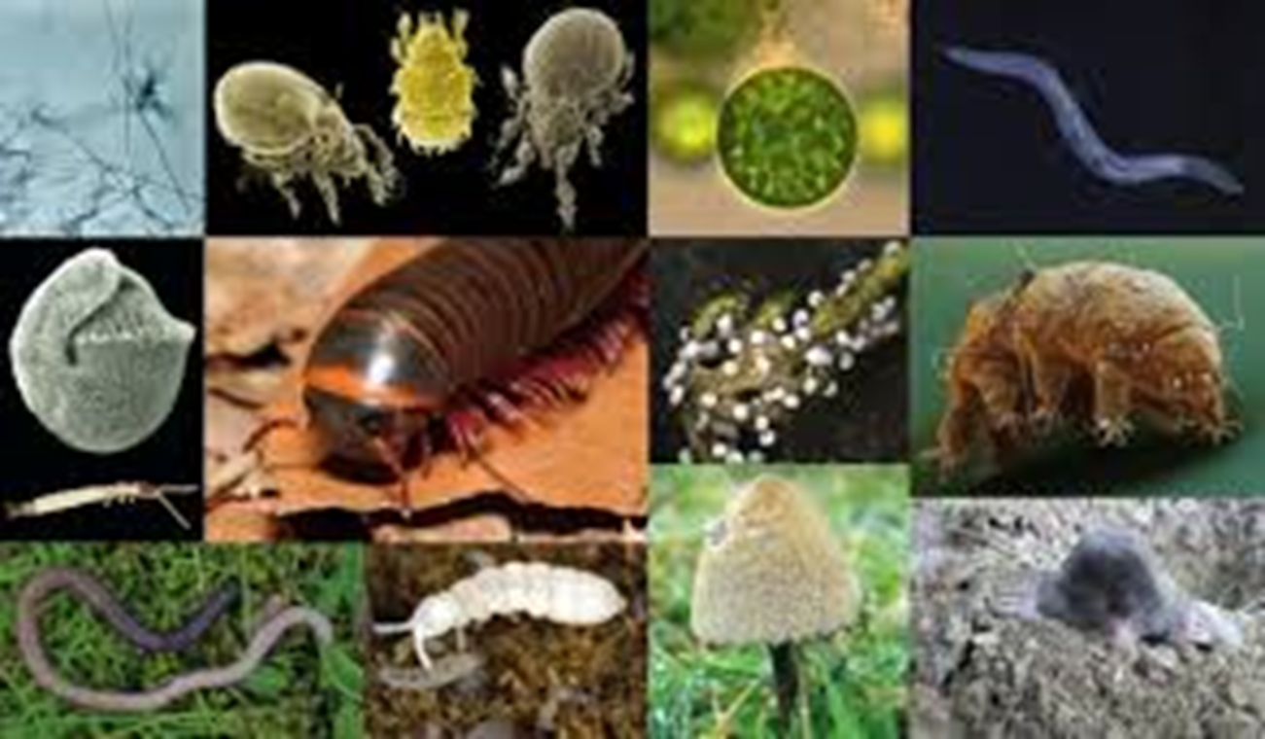
Livestock
Soil Livestock
Slide source: Laura Paine
Notes:
Let’s talk a little more about the soil. Controlling erosion is important, but we are becoming more aware that that is not enough. Soil health is important to the long-term sustainability of our farming systems. We need to be concerned not only about what our aboveground livestock are doing, but also about how healthy our soil livestock are.

