Slide 1
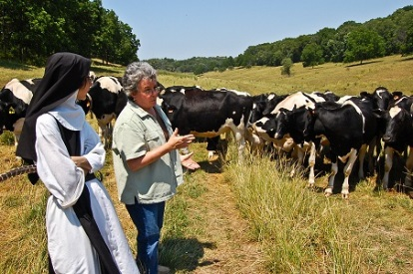
Laura Paine
Laura Paine has been involved in Wisconsin’s sustainable agriculture community in a variety of roles for more than 20 years.
From 2006 to 2014, she served as Grazing & Organic Agriculture Specialist for the Wisconsin Department of Agriculture, Trade and Consumer Protection.
Paine is currently Program Director for the Dairy Grazing Apprenticeship, a formalized, nationally accredited training program for beginning dairy farmers.
She has a Bachelor’s Degree in Botany from Southern Illinois University, a Master’s Degree in Horticulture from the University of Wisconsin, and is a Certified Educator for Holistic Management International.
She and her husband raise and direct market grass-fed beef on their farm near Columbus, Wisconsin.

