Slide 1
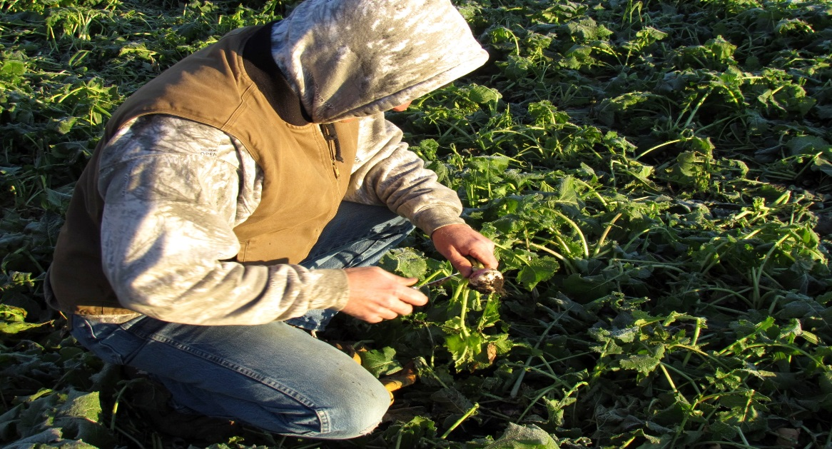
Land Stewardship Project
Mission- Foster an ethic of stewardship for farmland, to promote sustainable agriculture and to develop sustainable communities.
Landowner Engagement- Meet with farmers and landowners individually and spend time in a 1-1 setting. We discuss conservation goals, help recognize and verbalize obstacles to those goals, then form a plan to overcome these obstacles.
Chippewa 10% Project- Work with farmers and landowners to improve water quality throughout the watershed.
Perennial Cover
Cover Crops
Soil Health Monitoring
Input Reduction
Managed Grazing
Andy Marcum

