Slide 1
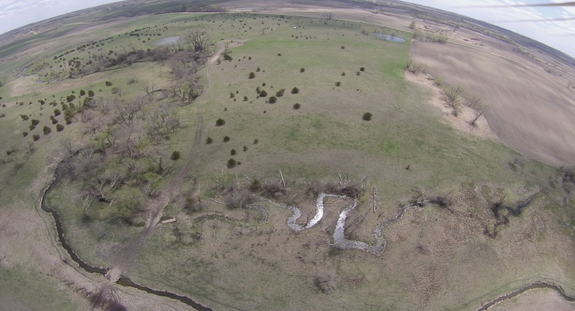
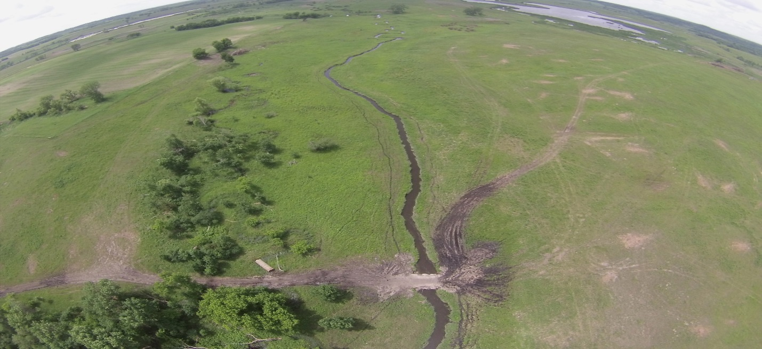
Invasive Species Removal
Before
After
Slide source: Andy Marcum

