Slide 1
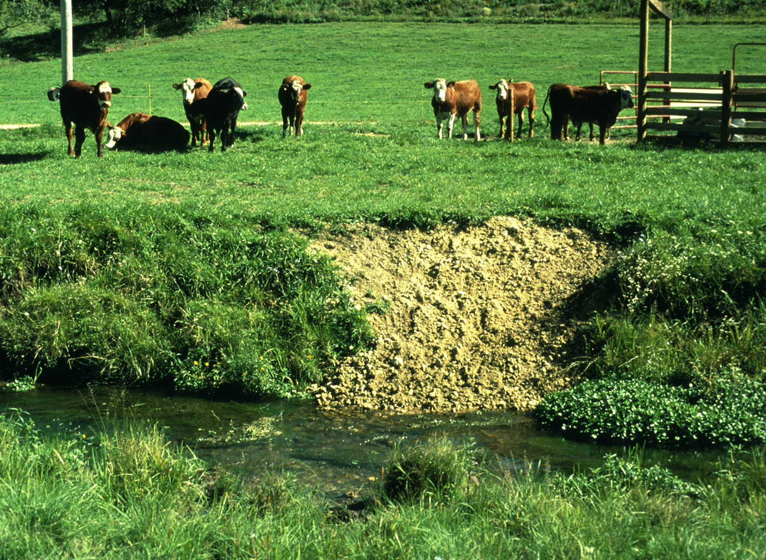
Improving Aquatic Habitat
Slide Source: Laura Paine
Lyons, J., B.M. Weigel, L.K. Paine, and D.J. Undersander. 2000. Influence of intensive rotational grazing on bank erosion, fish habitat quality, and fish communities in southwestern Wisconsin trout streams. Journal of Soil and Water Conservation. 55: 271-276.
Notes:
These are results from a study we did with Dave and others in the DNR. We looked at 20 trout stream reaches in SW WI and compared continuous grazing, managed grazing, grassy buffer strips and woody buffer strips. For bank erosion, it was not surprising that the unrestricted grazing resulted in the greatest amount of bank erosion. The surprising thing was that woody buffers had the second highest amount and that MIG created conditions similar to grassy buffer strips. For in-stream habitat (pools, riffles, substrate, channel depth and width, etc.), MIG again came out similar to grassy bufferstrips and better than woody bufferstrips.

