Slide 1
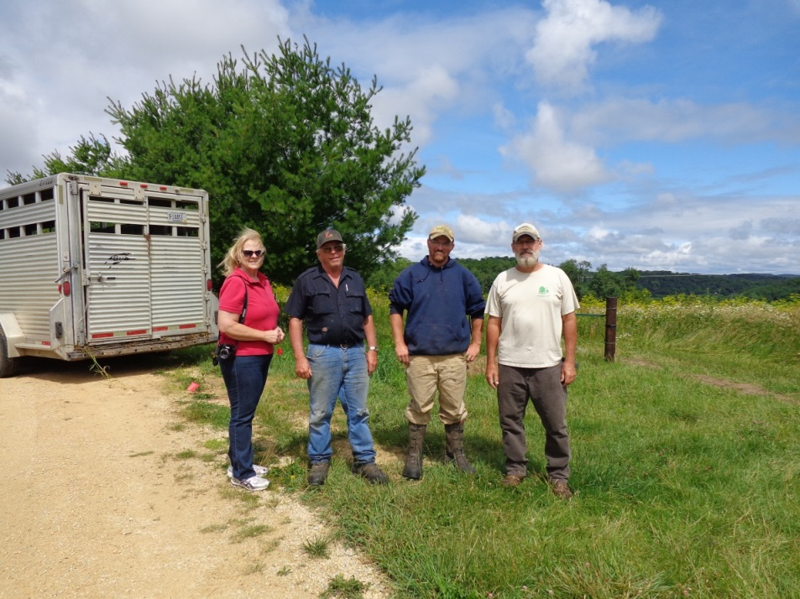
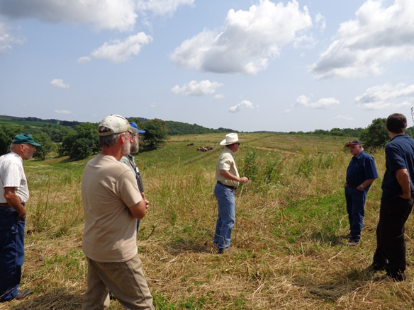
A Grazing-Conservation Partnership
Slide source: Laura Paine

