Slide 1
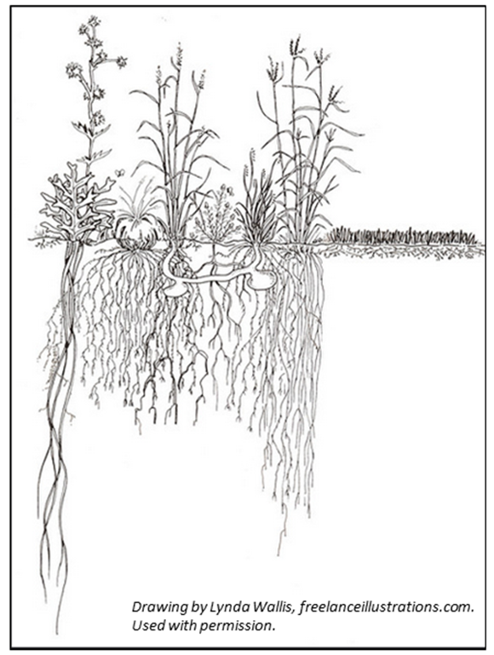
Diverse pastures increase intake
Plant competition
Water
Nutrients
Light
Space
Diversity enhances resource use efficiency
Slide source: Laura Paine
Notes:
Here again, we find that the same things that increase productivity in pastures, can also contribute to soil health. A number of studies have found that diverse mixtures actually increase the capture of sunlight and the productivity of the pasture sward.

