Slide 1
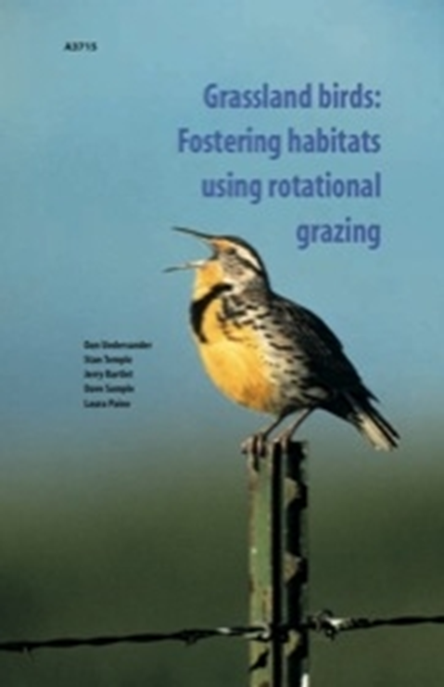
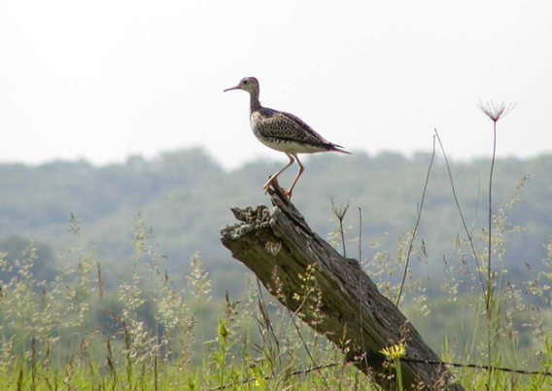
Creating a Nesting Refuge
Woods
Refuge Paddocks
Cool Season Paddocks
Grassland bird nesting season: May and June
Slide Source: Laura Paine
Notes:
Here is a model of our ‘bird-friendly’ pasture system, with ¼ to 1/3 of the pasture set aside as a nesting refuge. By setting aside this nesting refuge in the pasture system, there is a place where grassland birds can nest undisturbed. This is also a niche for native warm season pastures. The publication in the upper corner is another Extension bulletin that came out of our research. This idea of a nesting refuge has caught on quite well around the region.

