Slide 1
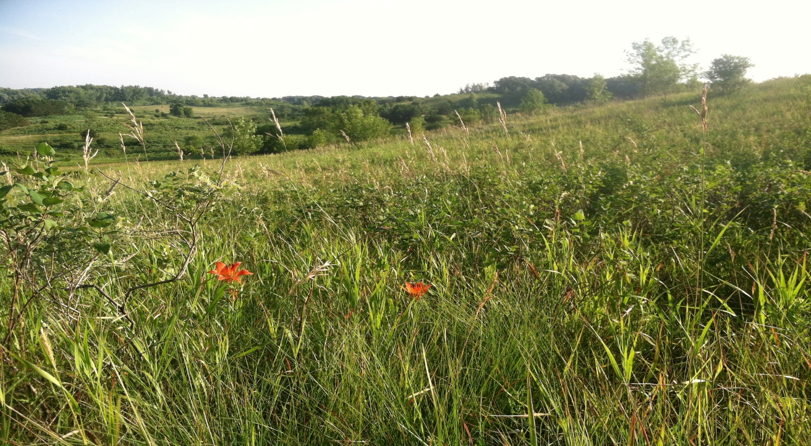
By convening farmers, agencies and recreational landowners; in working cooperatively to meet conservation goals, we create a community environment for stewardship and strengthen communities by supporting their efforts.
Slide Source: Andy Marcum

