Slide 1
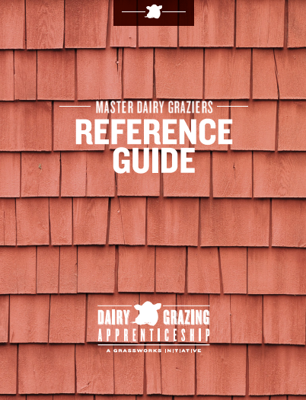
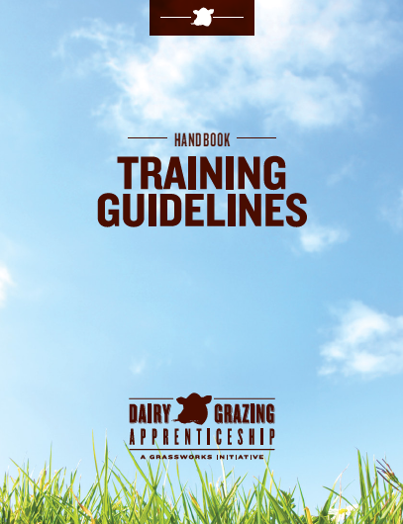
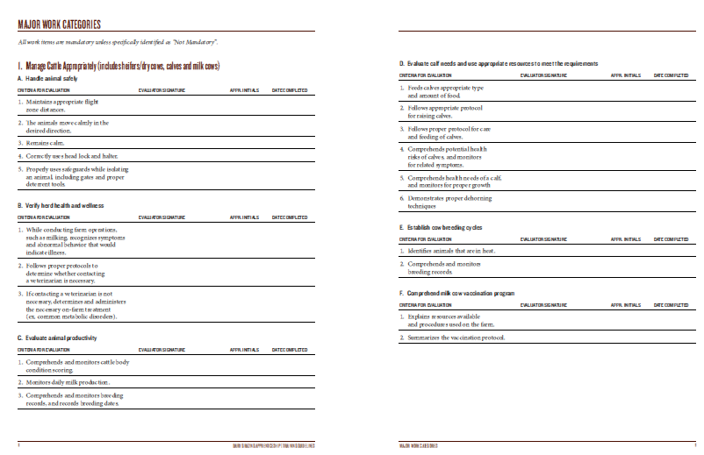
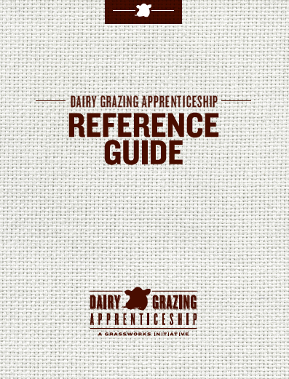
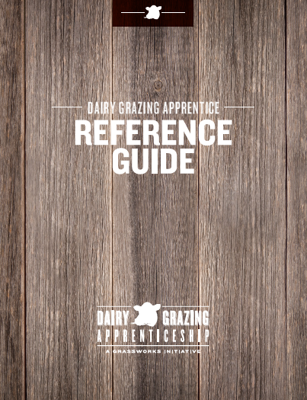
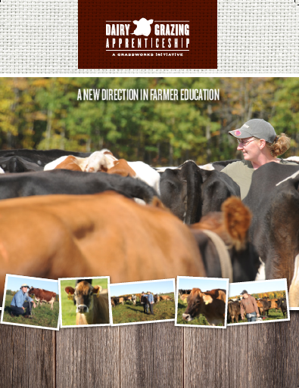
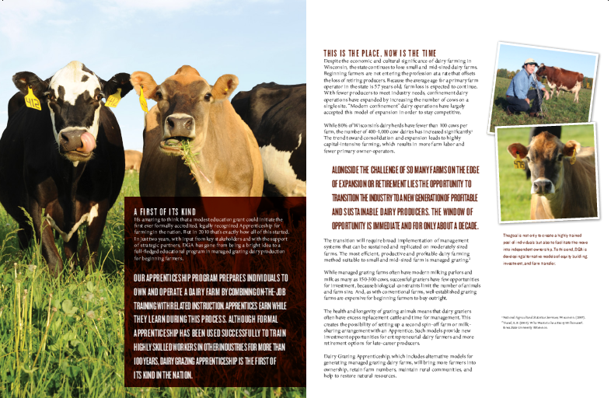
A Conservation Farming Apprenticeship
2 year program.
3712 hrs. on-the-job training on a working dairy farm.
288 hrs. related classroom instruction.
Laura Paine
Program Director
Dairy Grazing Apprenticeship
608-338-9039
lkpaine@gmail.com
Notes:
I’d also like to put in a quick plug for my organization. The Dairy Grazing Apprenticeship is a two year formal training program for beginning dairy farmers. We utilize pasture based system for our training program because it is the most effective way to both economically produce milk and protect the environment.

