Slide 1
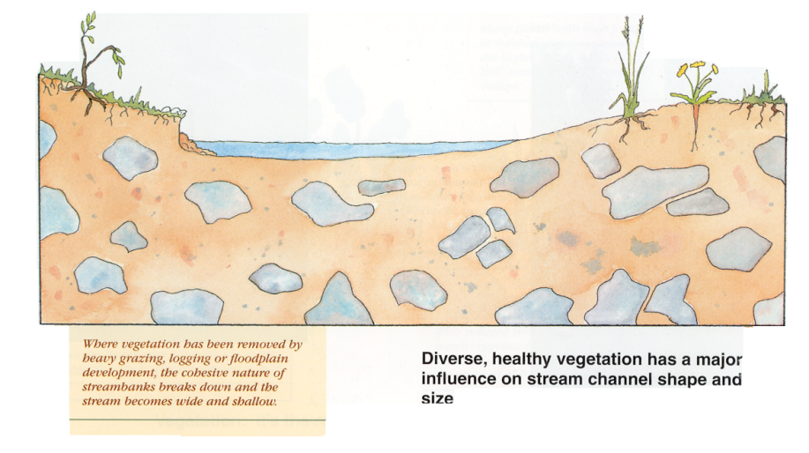
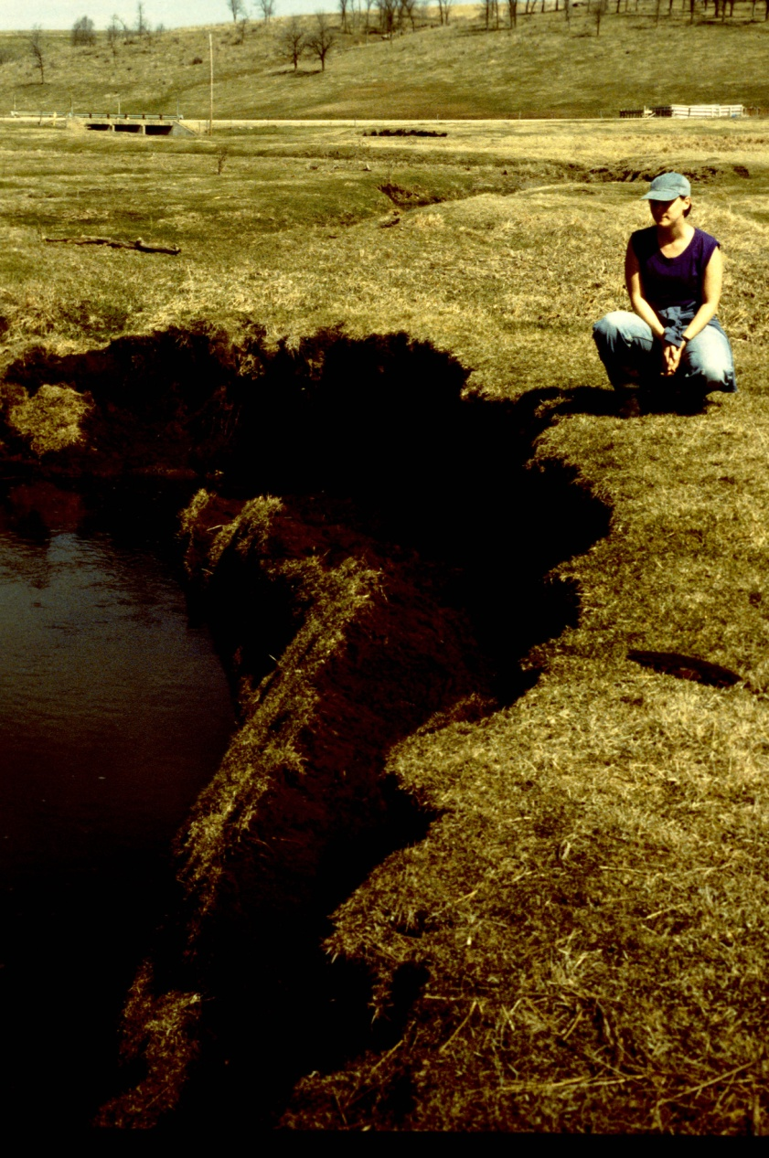
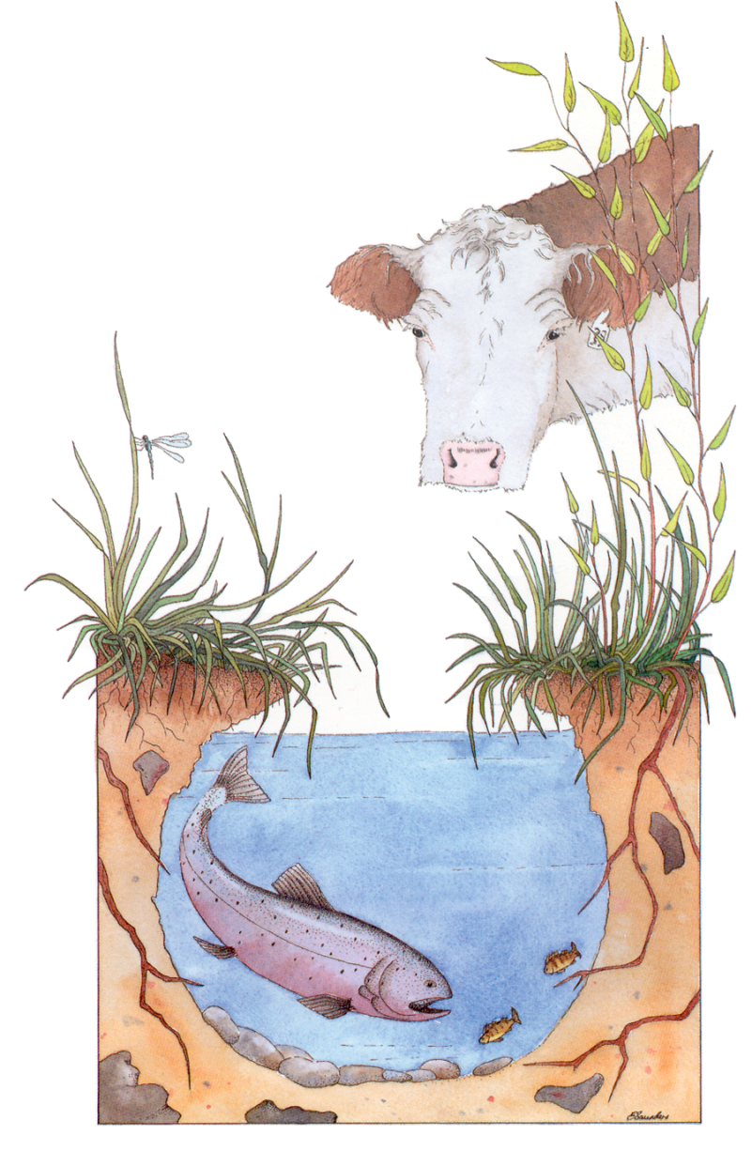
Aquatic Habitat & Bank Stability
Continuous Grazing
Rotational Grazing
Rotation
Residual
Rest
Slide Source: Laura Paine
Notes:
What we were finding goes back to the previous observation: by maintaining a rotation that limits the amount of time spent, leaving adequate residual, and then providing a long enough rest period between grazing events, we were able keep healthy deep rooted plants along the stream to protect the streambanks.

