Slide 1
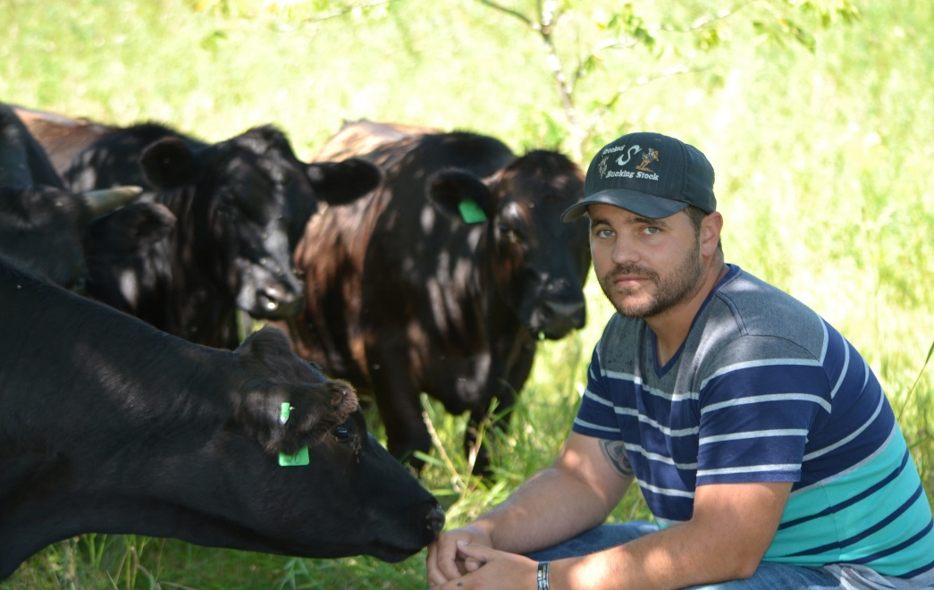
Andy Marcum
Andy Marcum is the Ag Lands Solutions Specialist for the Land Stewardship Project. His work focuses in the Chippewa River Watershed on the Chippewa 10% Project, a cooperative effort focused on increasing perennial cover throughout the watershed.
Growing up on a Hereford Ranch in Oregon, Andy has gained an extensive background in cattle and grassland management.
Currently Andy works with various landowners to improve production and profitability on their property
Andy also raises Grassfed Beef on his own ranch using intensive grazing management to restore degenerated pasture and Native Prairie.

