Slide 1
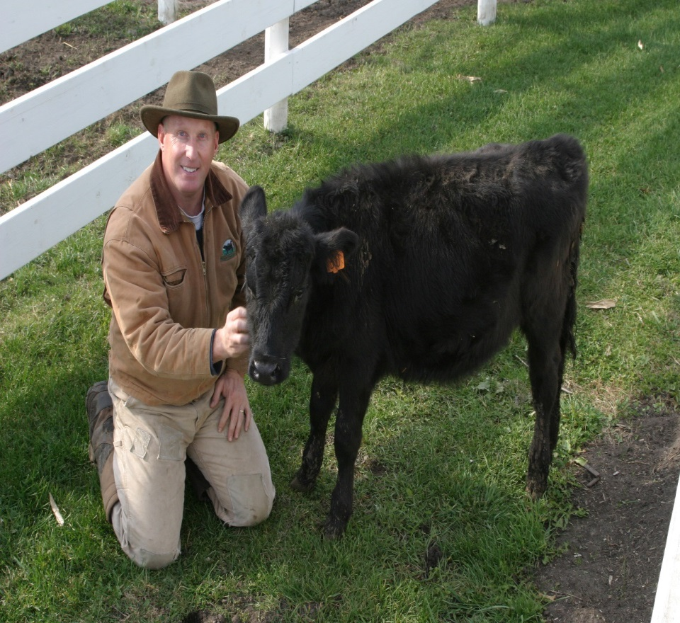
Rod Ofte is a fourth generation “Driftless” area farmer who operates an organic grass-fed beef ranch near Coon Valley, WI.
He holds a BS from the United States Military Academy at West Point, NY and a MBA from Boston University.
Mr. Ofte has over 25 years of experience in the food industry including time working in Europe, the Middle East and Asia.
He is President of Norse Group Consulting, General Manager of the Wisconsin Grass-fed Beef Cooperative, and a core member of the Wallace Center Pasture Project team.

