Slide 1
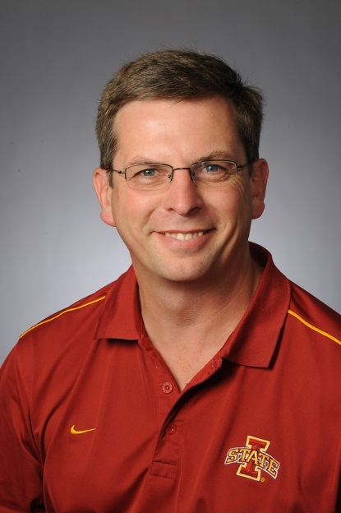
Larry Tranel received his B.S. and M.S. from UW-Platteville in Ag Economics. Spent 10 years as a Dairy Farm Management Agent in Iowa County Wisconsin with UW-Extension.
The past 15 years as he has served as Dairy Field Specialist with Iowa State University Extension and Outreach.
Larry specializes in financial analysis of all types of dairy farms; dairy facilities, low cost milking parlors and cow comfort.
Recent work includes Millionaire Model Dairy Farms and Organic Dairy financial analysis and comparison.

