Slide 1
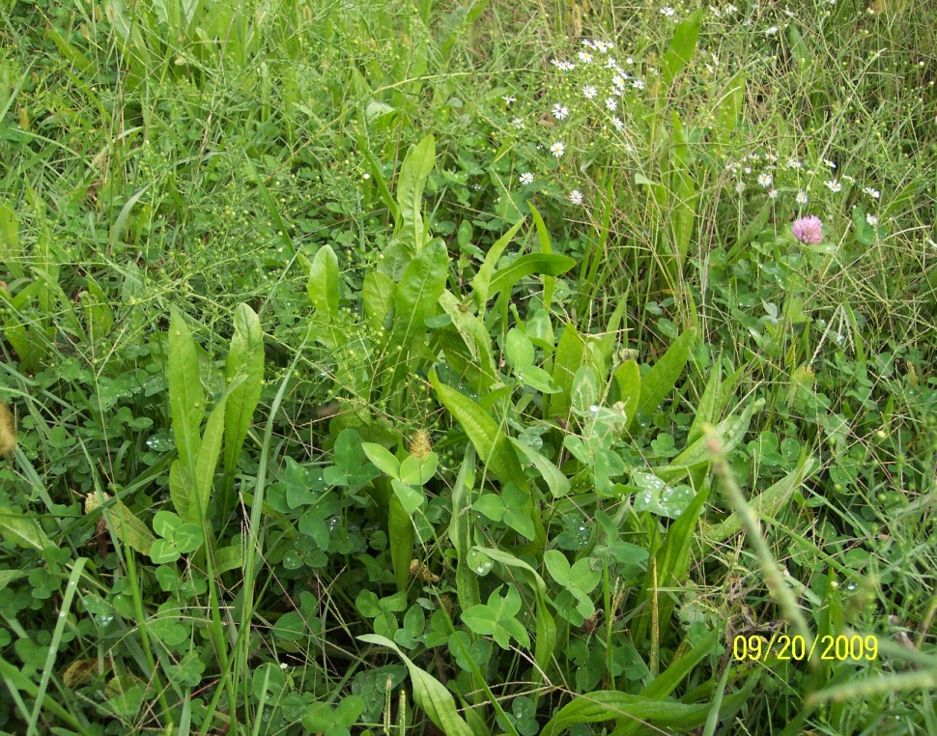
Why High Brix in Forages?
Research shows that High Brix forages increase animal gains and milk production.
High Brix Forages also are more drought resistant, freeze tolerant, and more resistant to plant disease and pests
(Moorby, 2001).
(Moller, 1996).
(Downing & Gamroth, 2007; Miller, et al, 1999).
(Allison, 2007).
(McKenzie, 2007).
Slide Source:
Allen Williams

