Slide 1
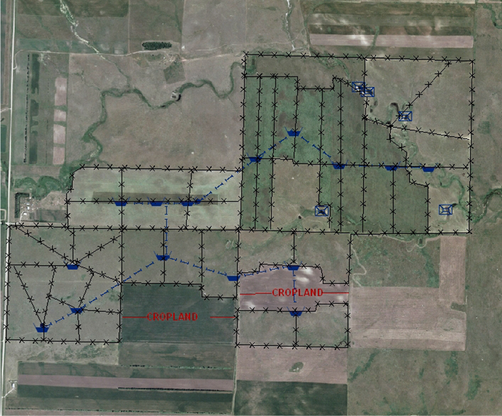
Water Resource Layout
Slide Source:
Allen Williams

