Slide 1
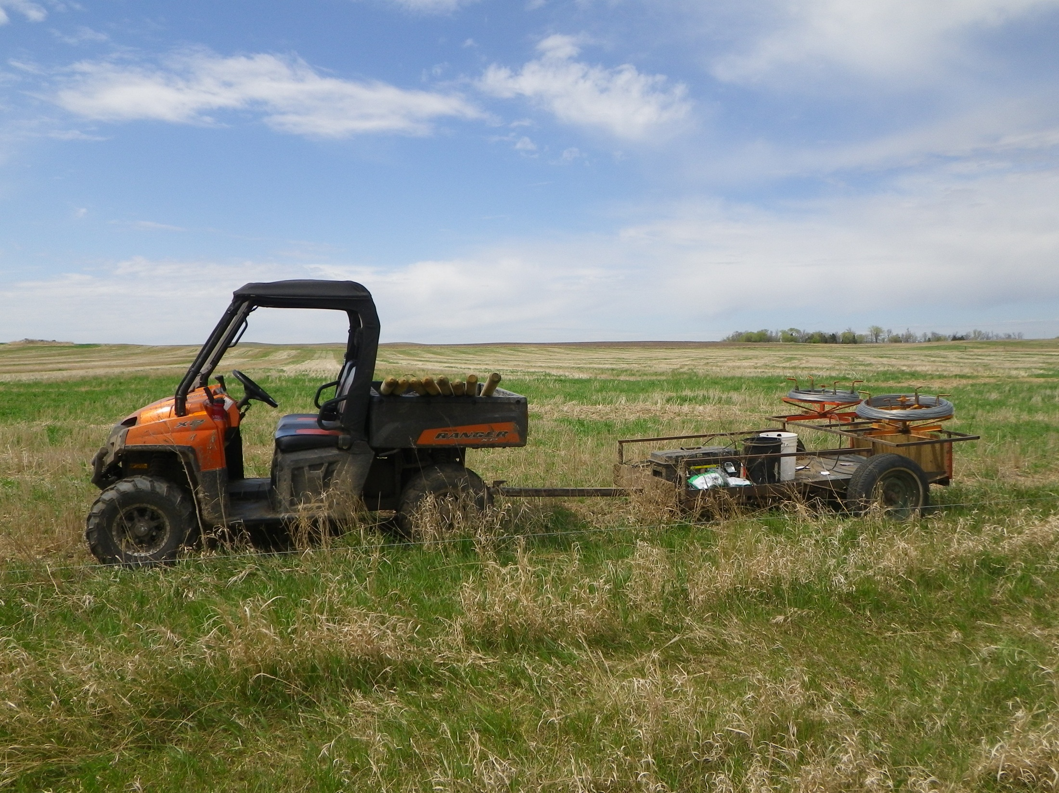
Variety of Ways to Get Job Done
Slide Source:
Allen Williams

