Slide 1
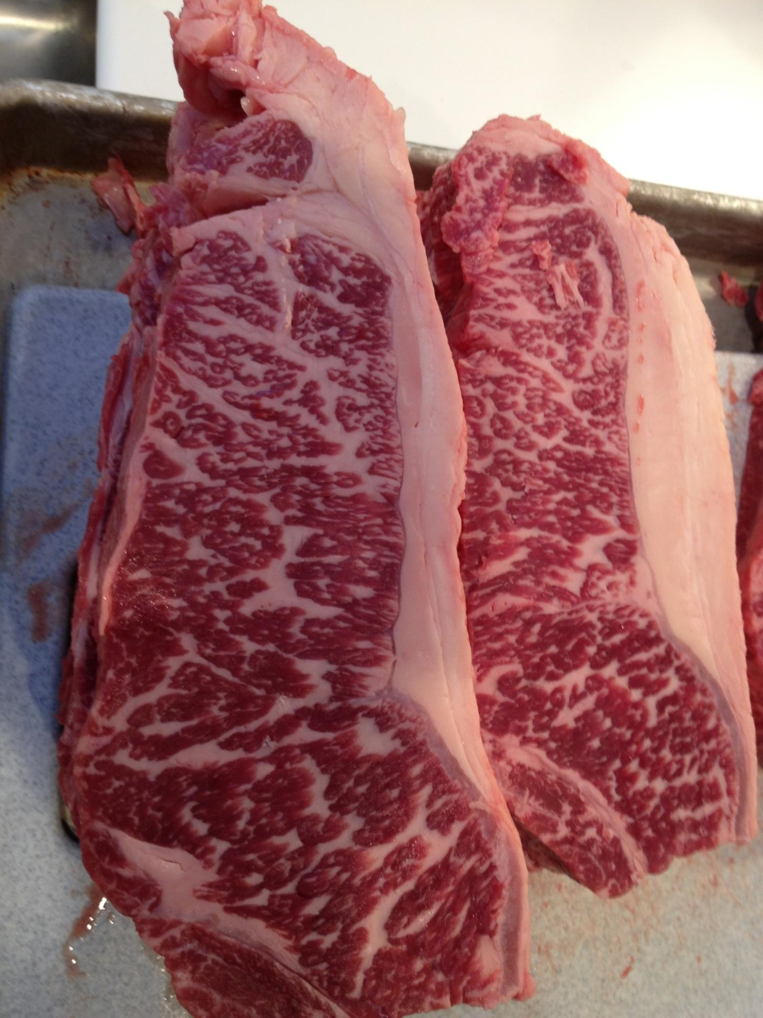
USDA Prime Grass Finished Beef
Slide Source:
Allen Williams

