Slide 1
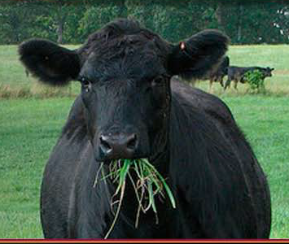
Thank you!
Slide Source:
Allen Williams

