Slide 1
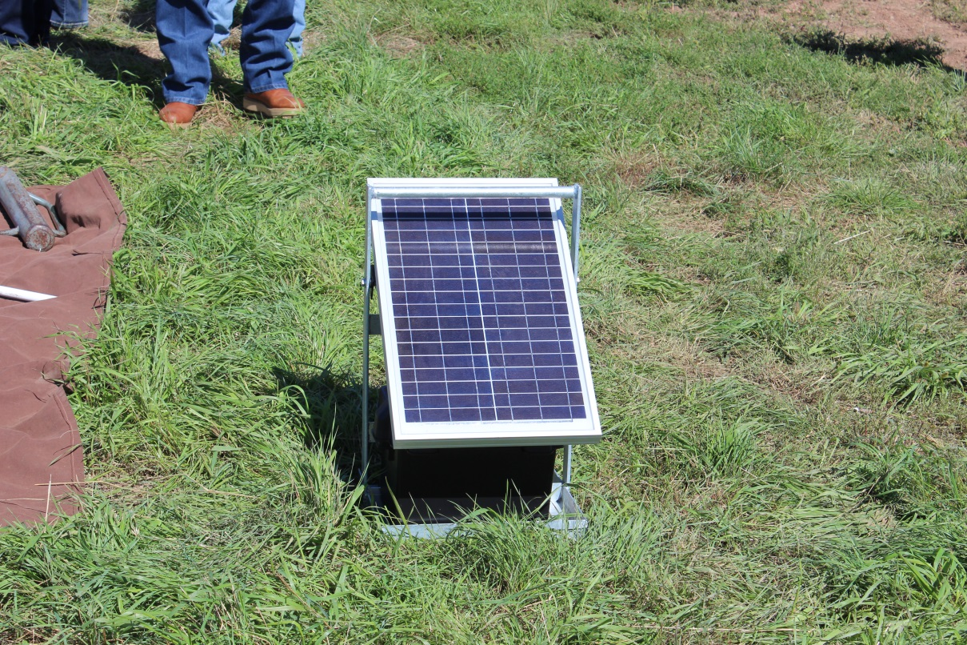
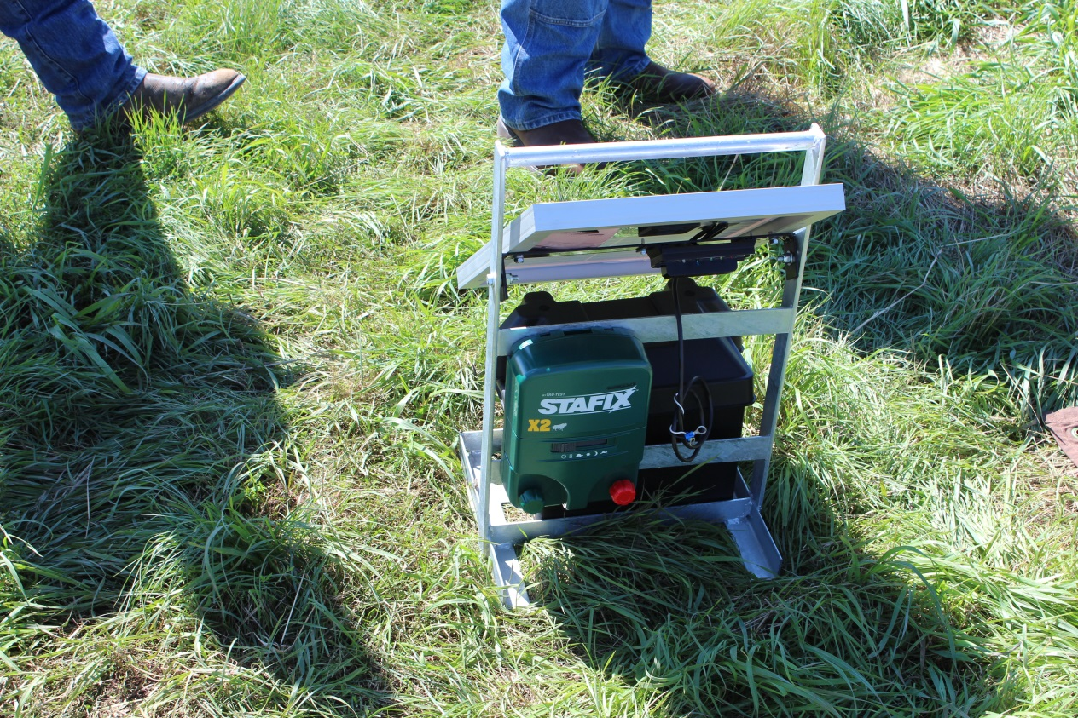
Solar Power Fencing
Slide Source:
Allen Williams

