Slide 1
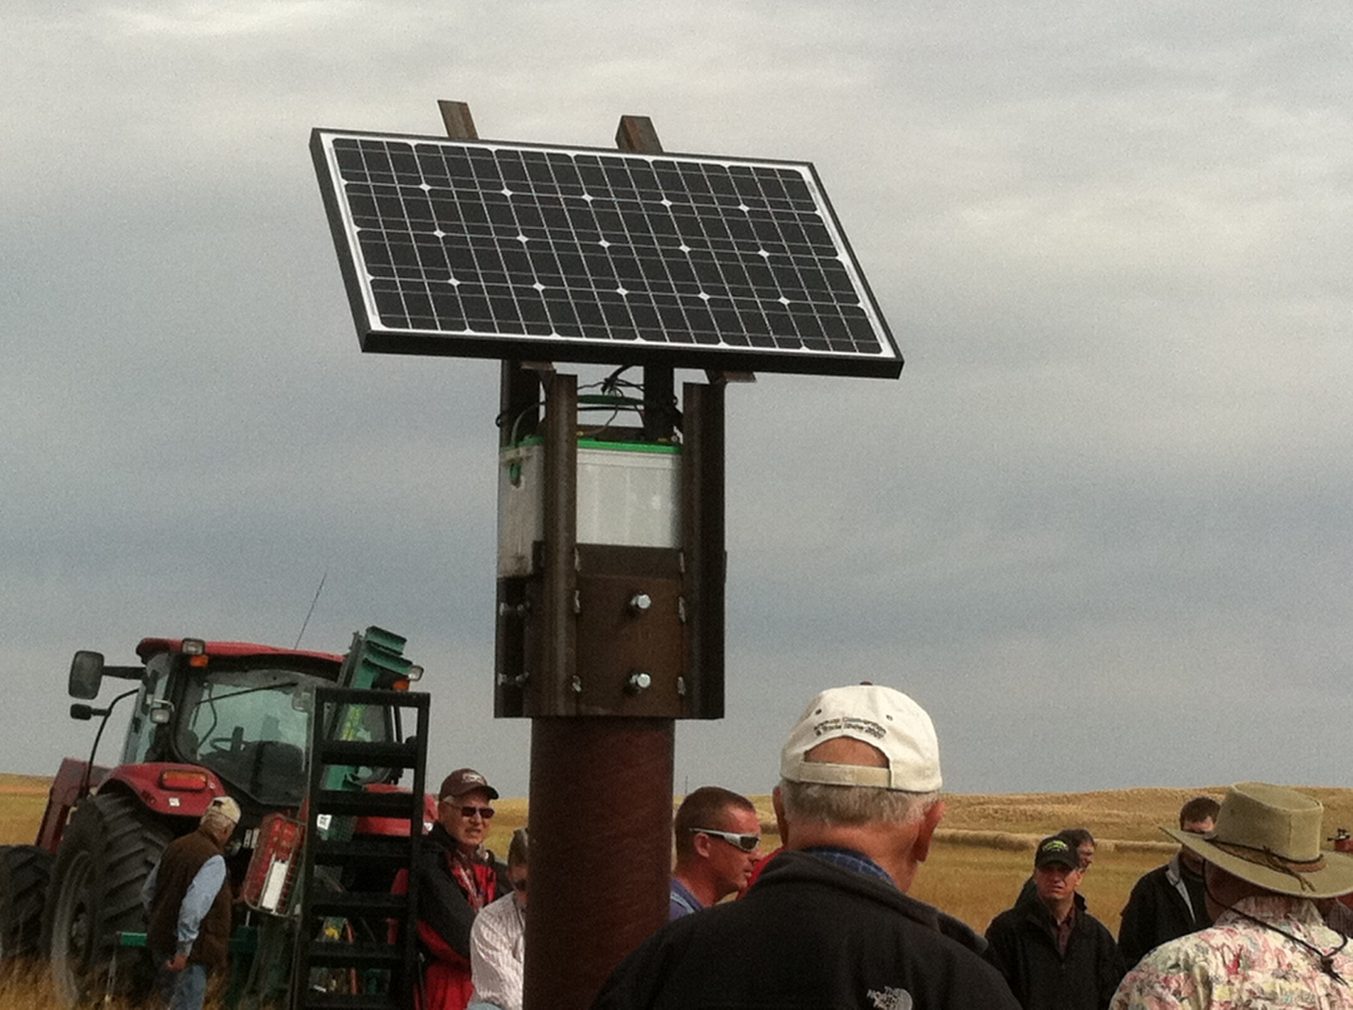
Solar Power Fencing
Slide Source:
Allen Williams

