Slide 1
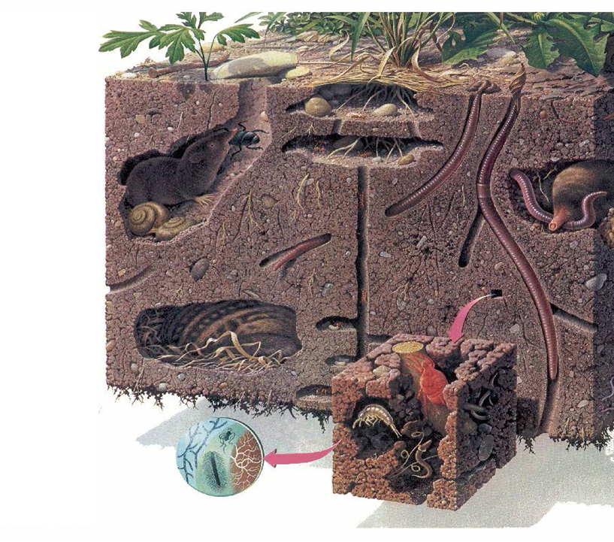
Life in the Soil
Soil Foodweb Inc.
Dr. Elaine Ingham
www.soilfoodweb.com
Slide Source:
Allen Williams

