Slide 1
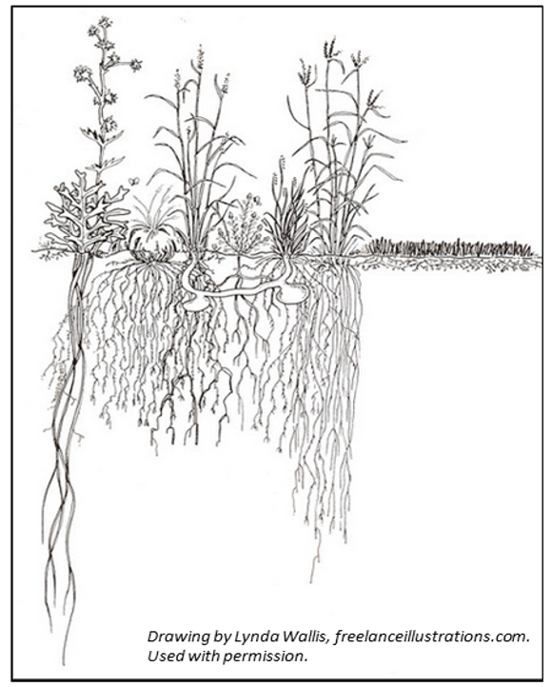
Monoculture
Diversity/Complexity
Diversity/Complexity
Slide Source:
Allen Williams

