Slide 1
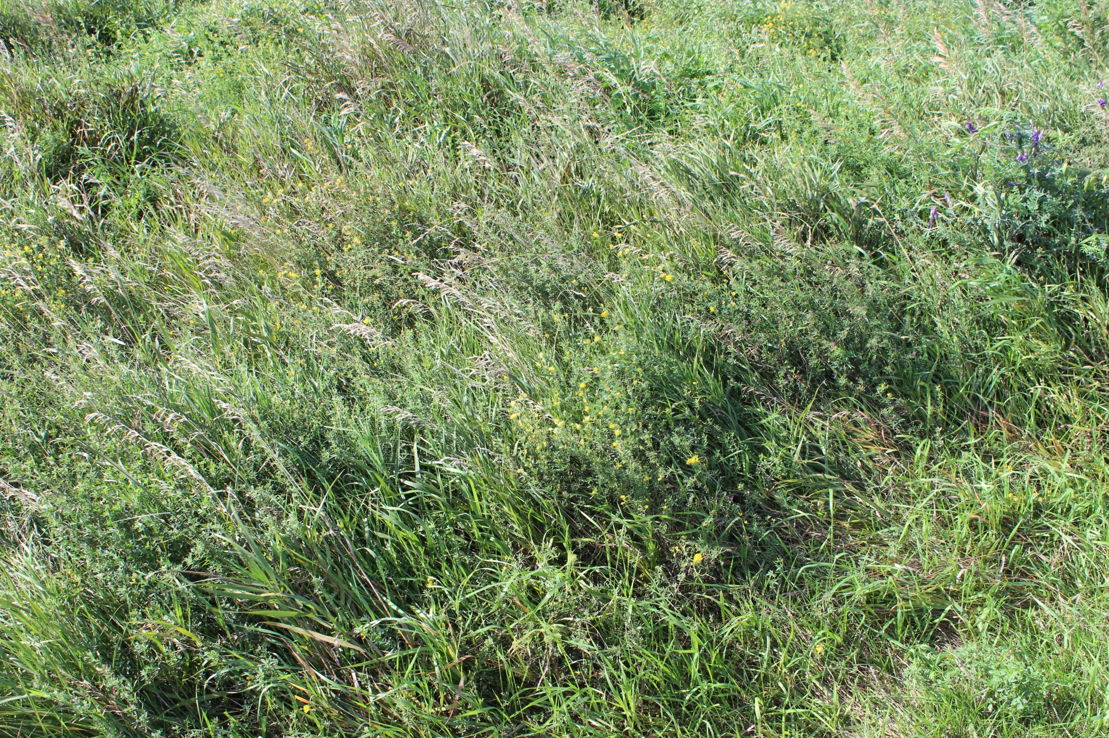
Pollinators
Slide Source:
Allen Williams

