Slide 1
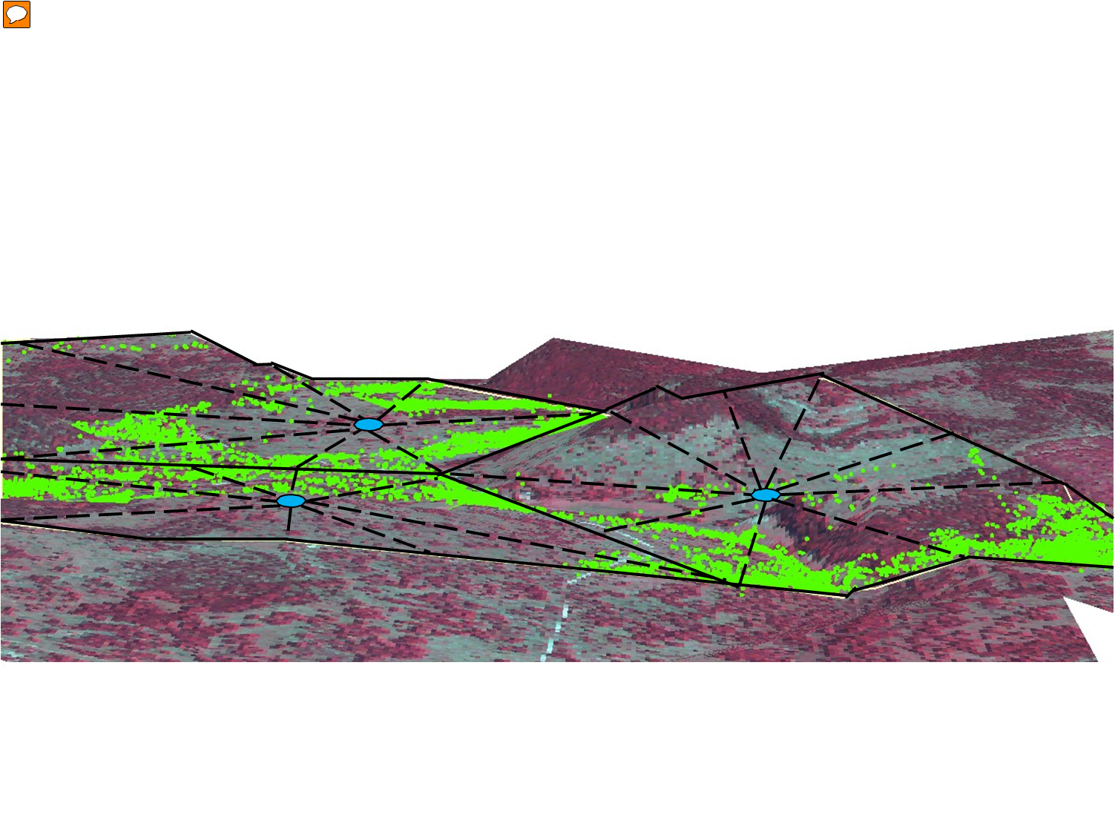
Planned Multi-Paddock Grazing
Under Planned Multi-Paddock Grazing Practices Carrying Capacity Increased from 21 ac/cow to 9 ac/cow.
Slide Source:
Allen Williams
Courtesy: R. Teague, TAMU

