Slide 1
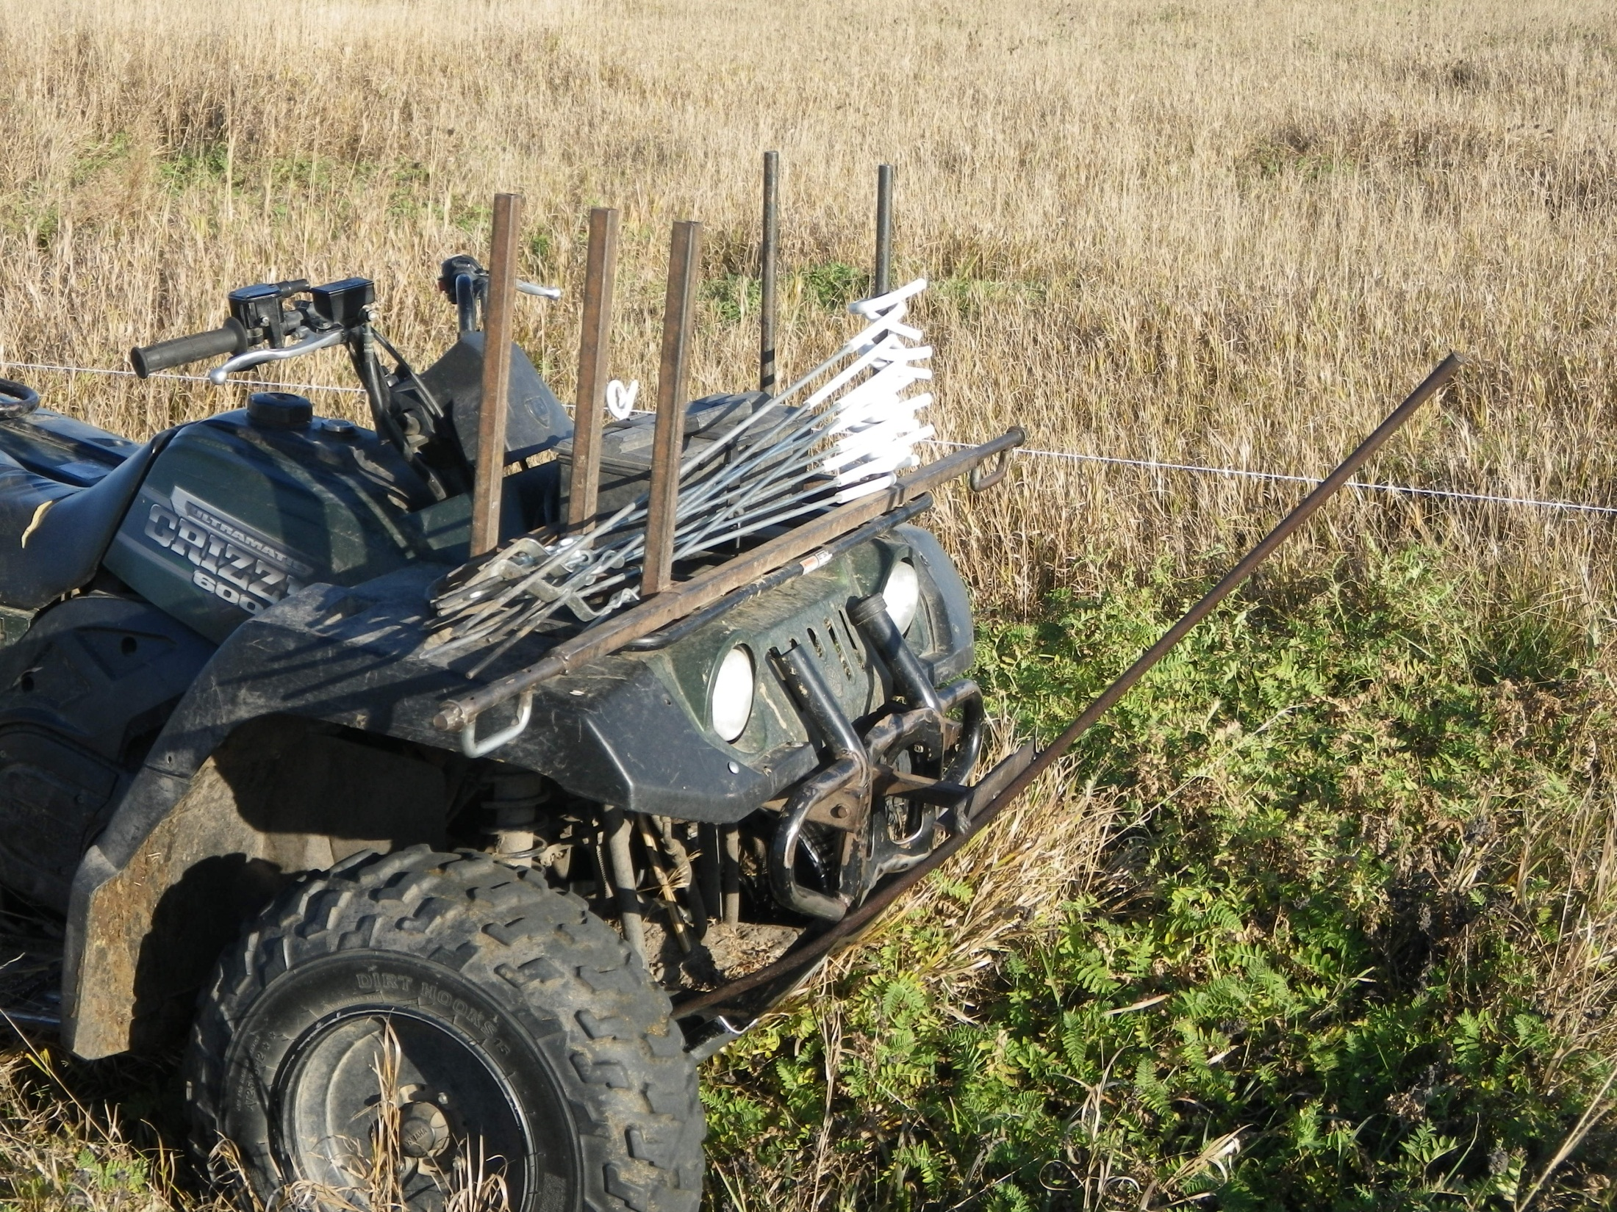
Pigtail Post Rack
Slide Source:
Allen Williams

