Slide 1
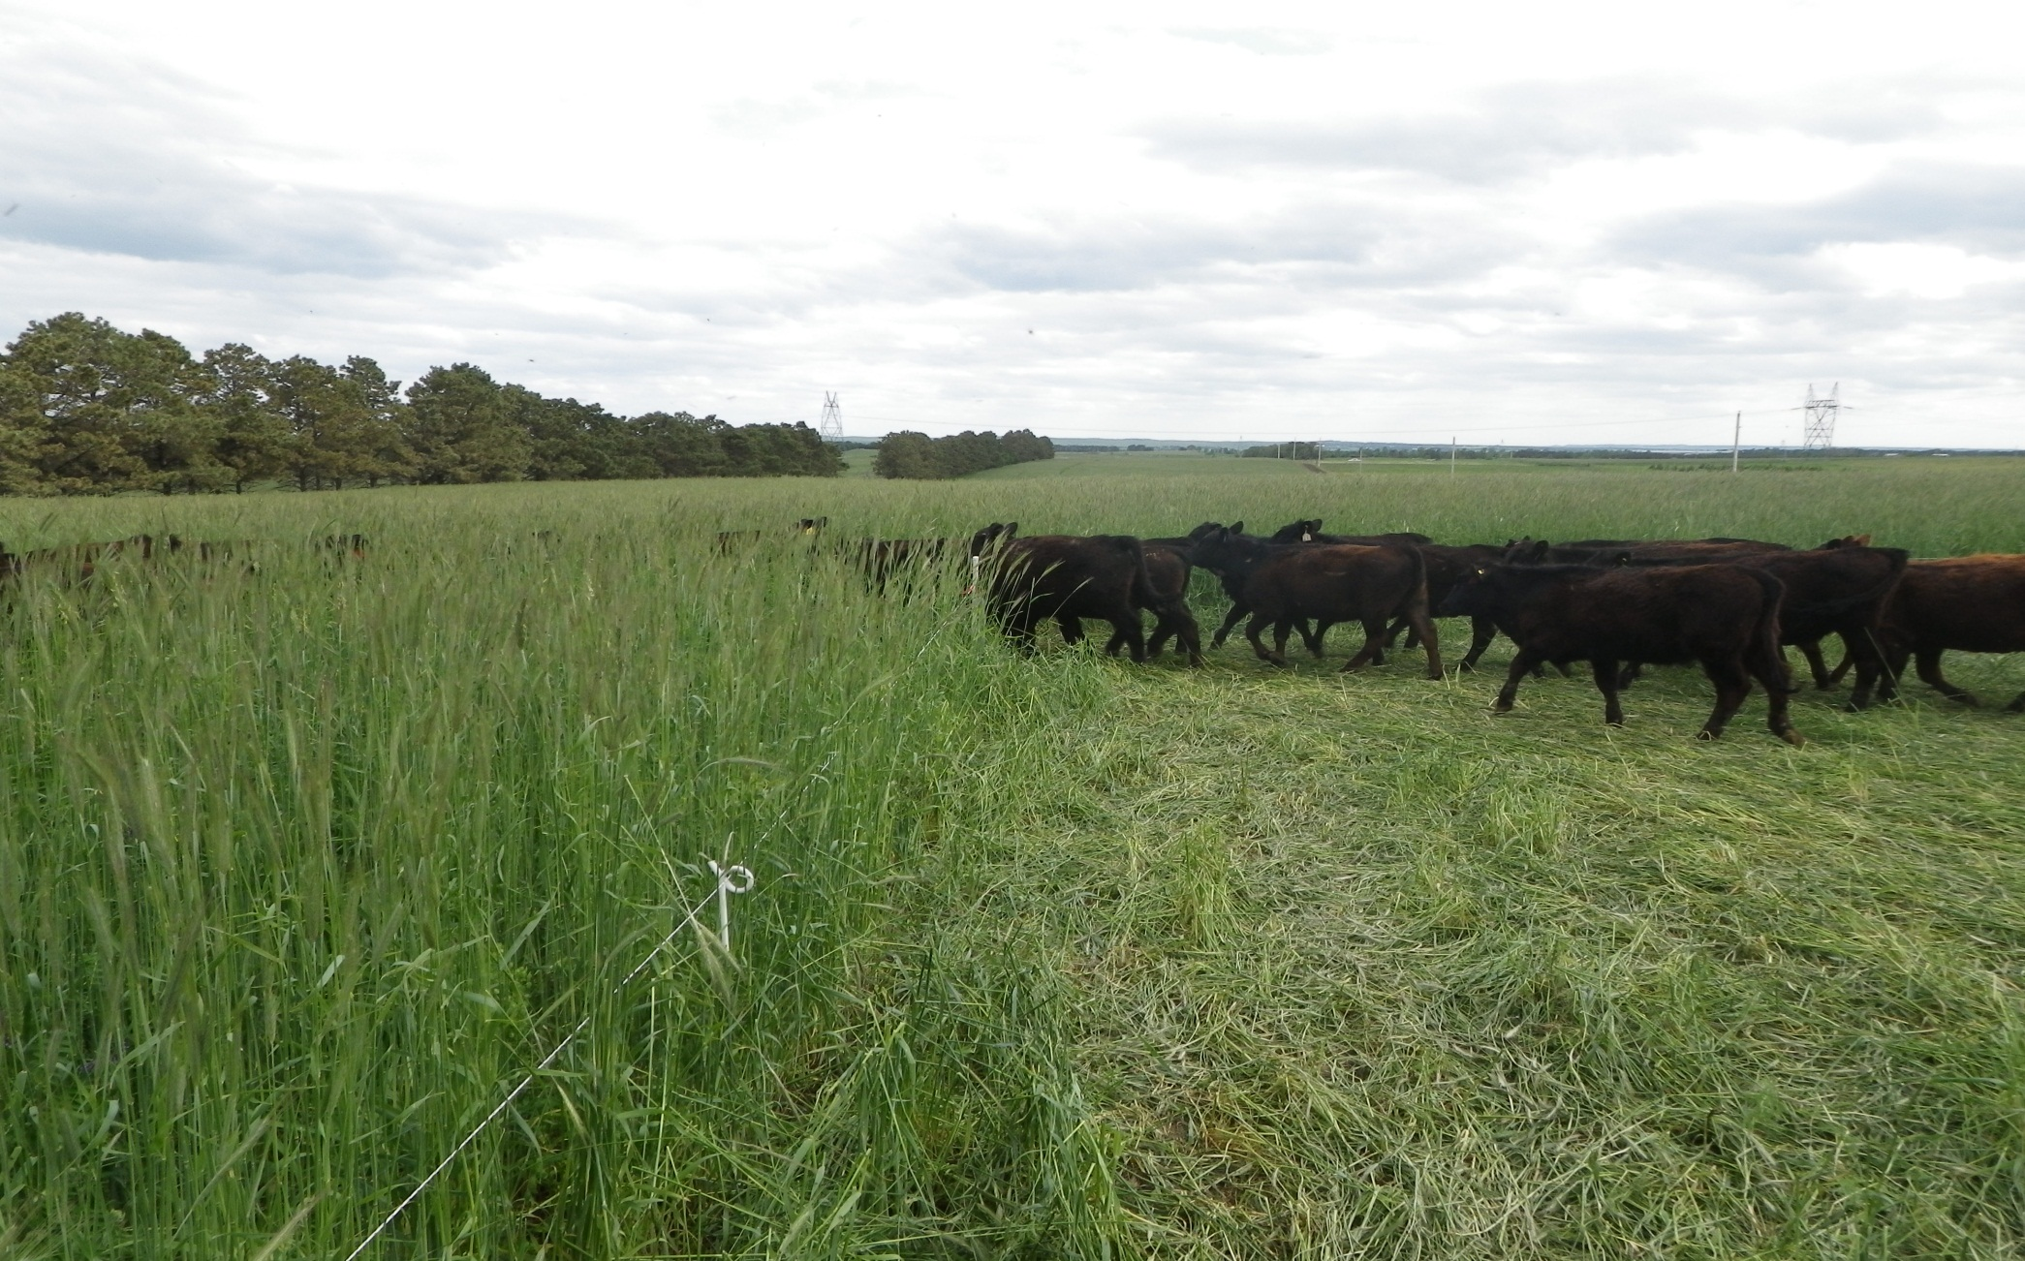
Next Move
Slide Source:
Allen Williams

