Slide 1
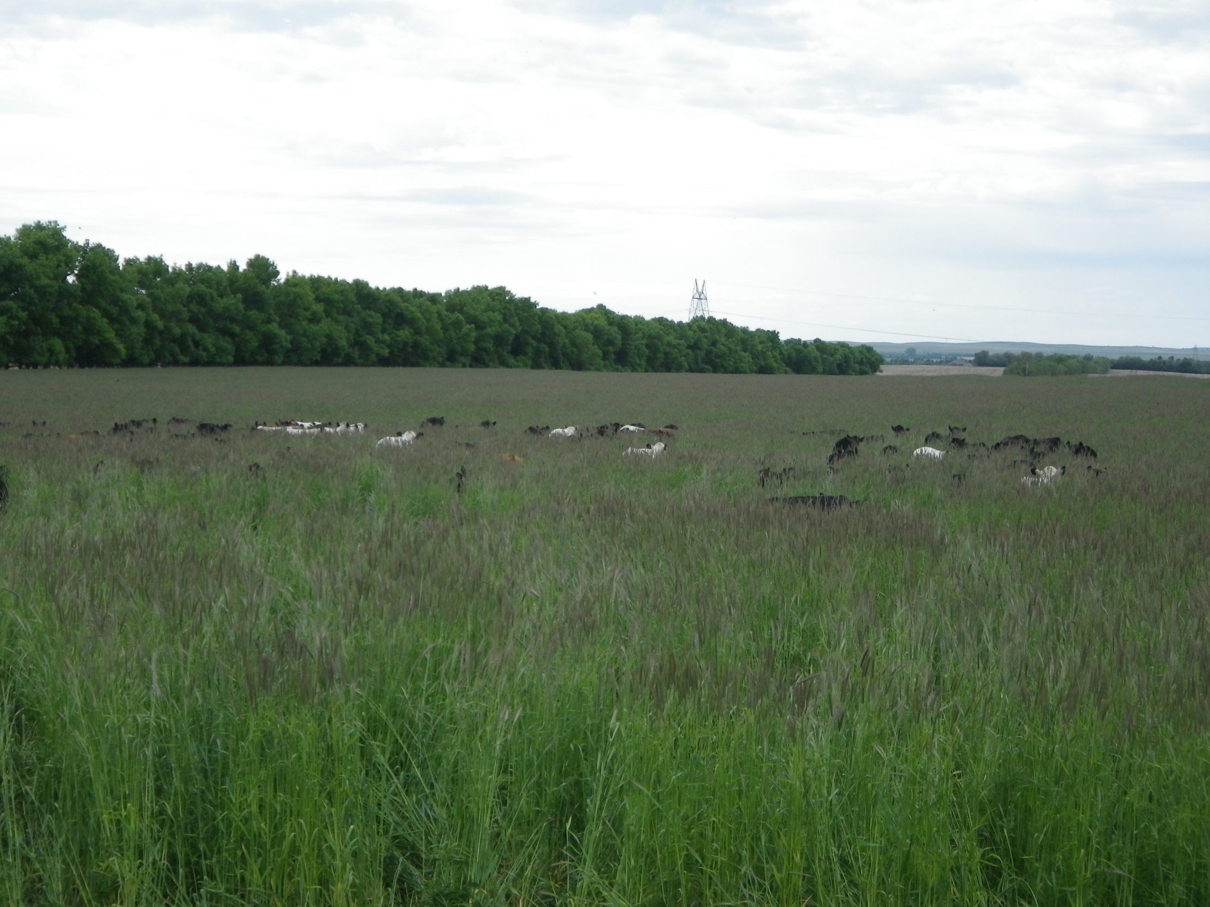
New Move
Slide Source:
Allen Williams

