Slide 1
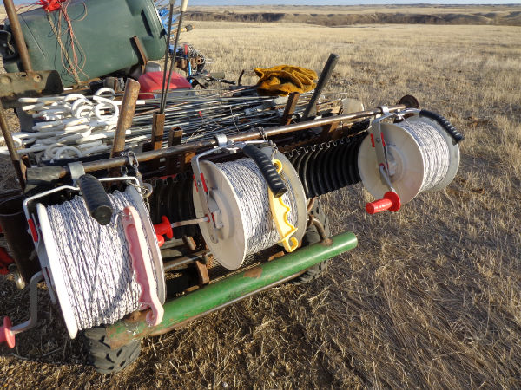
Multiple Strands
Slide Source:
Allen Williams

