Slide 1
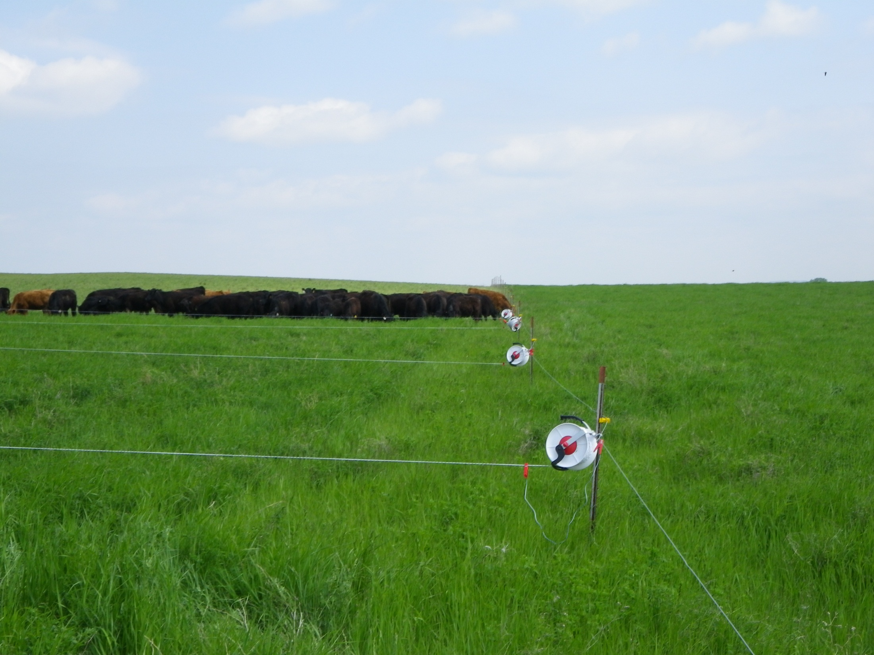
Multi-Paddock Construction for Multiple Daily Moves
Slide Source:
Allen Williams

