Slide 1
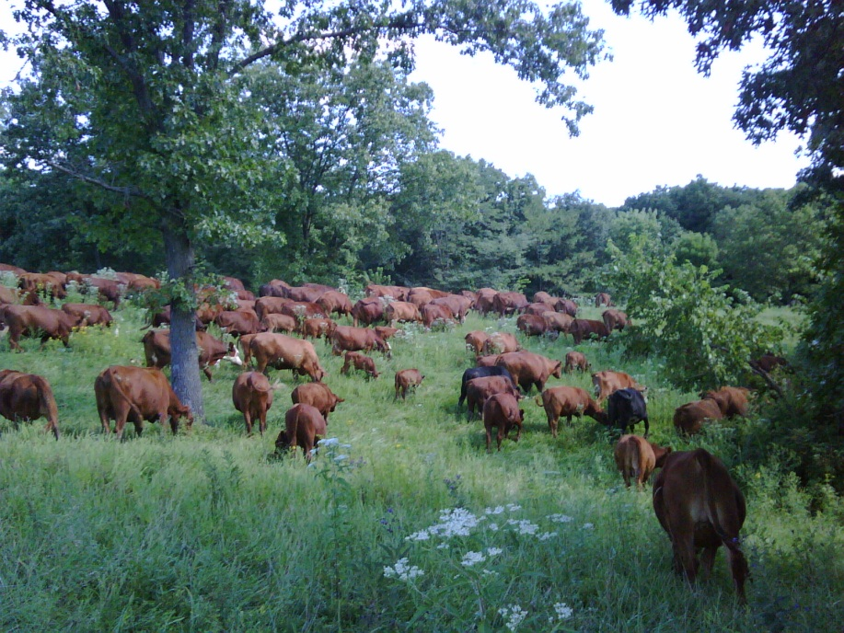
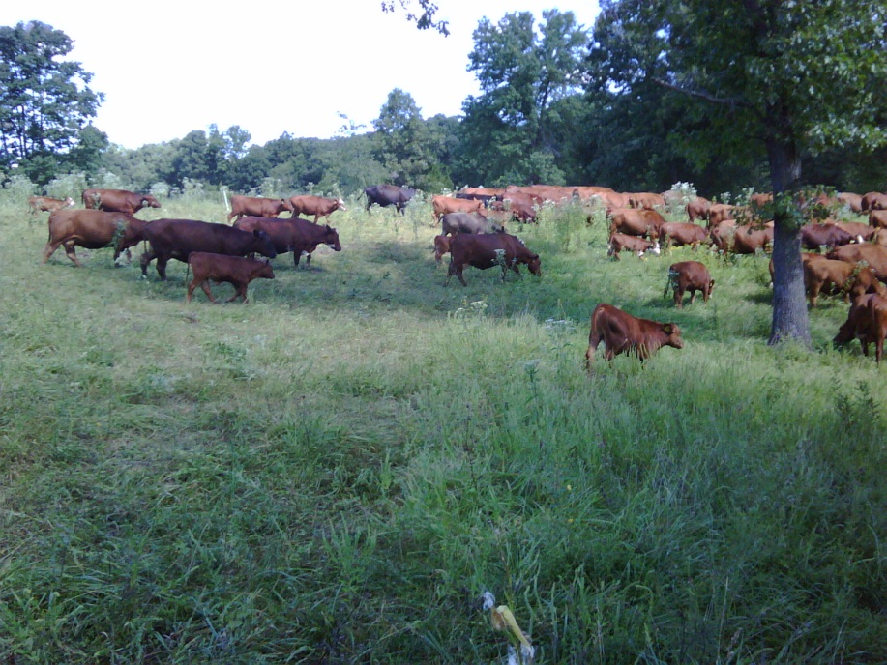
Moving the “Mob”
Slide Source:
Allen Williams

