Slide 1
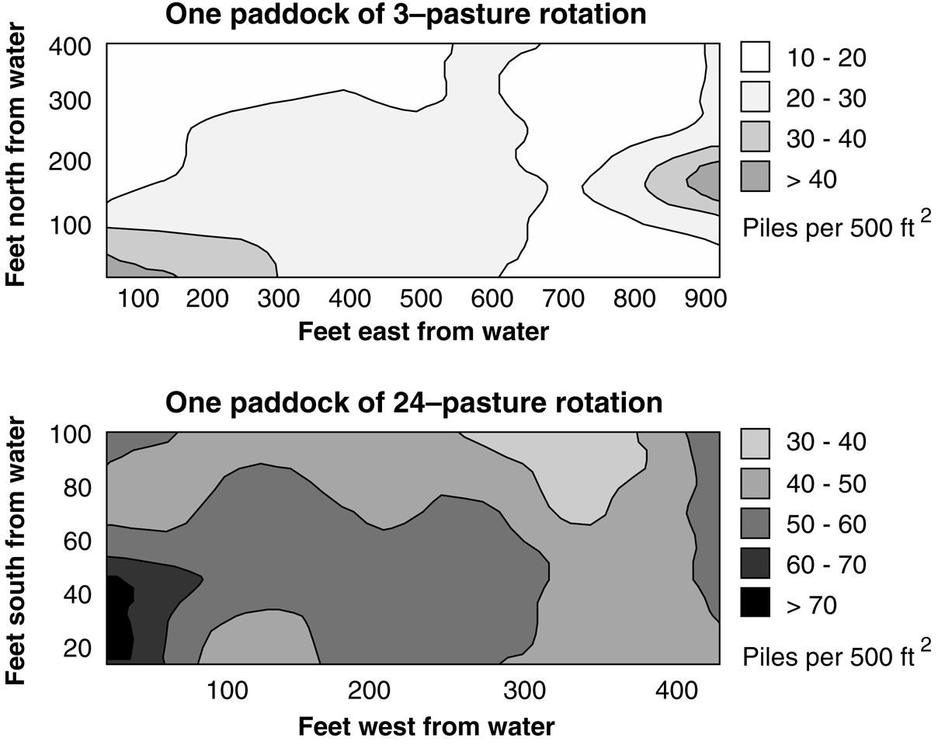
Manure Distribution
Slide Source:
Allen Williams
Notes:
In the 3-paddock system (analogous to continuously grazed pastures) very few manure piles are deposited in the main paddock area. There is a concentration of manure near shade and water. I frequently ask the audience to identify the areas of the field where manure piles are most densely concentrated (shade, east end; water, southwest corner).
In the intensively grazed 24-paddock system there is a much more even distribution of manure piles in the pasture creating a higher density of manure piles in the main paddock area. There is still a concentration of nutrient near water but the trends are less pronounced.

