Slide 1
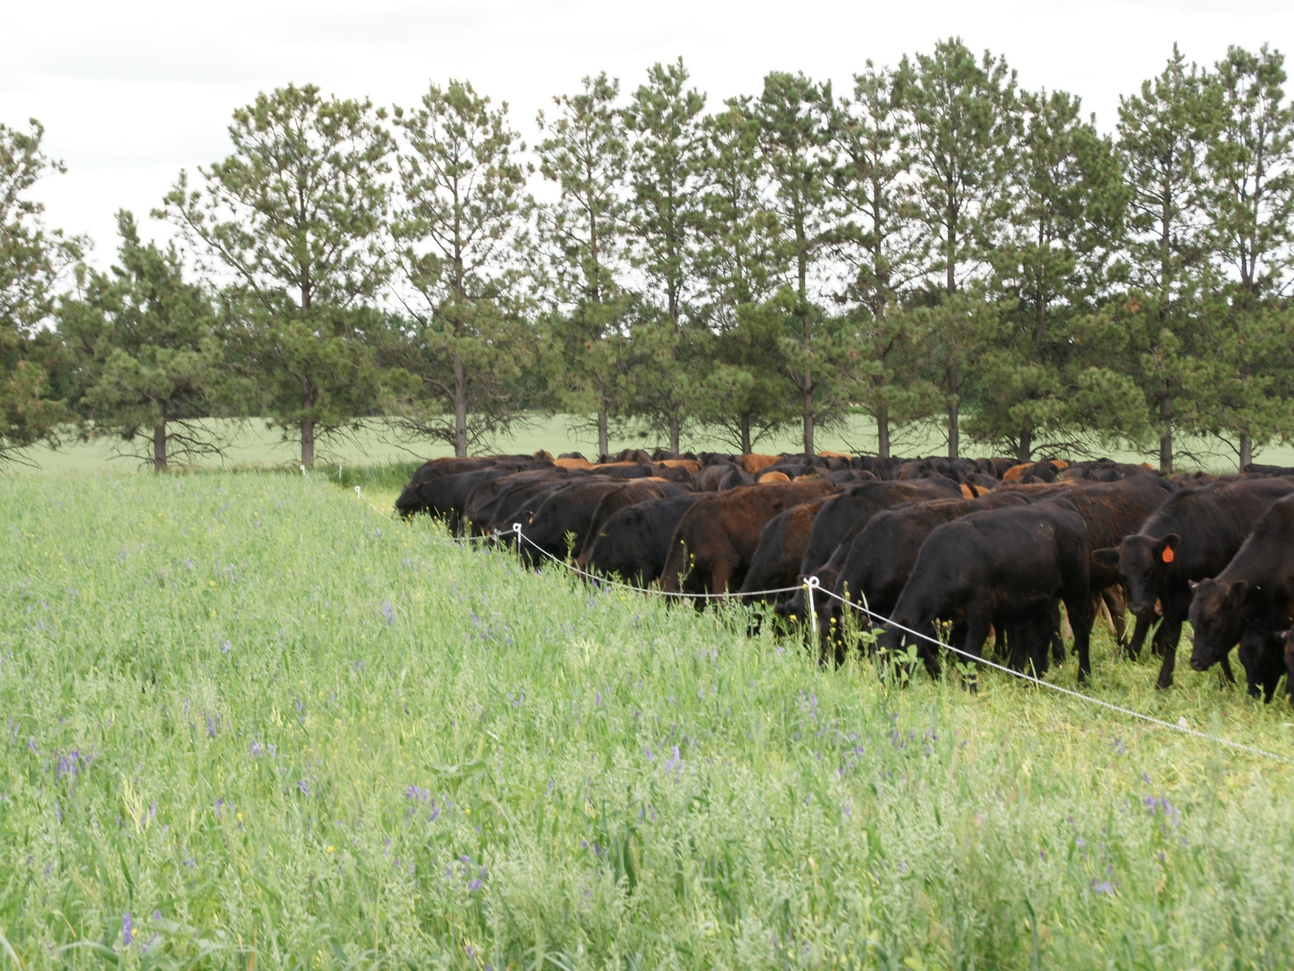
Livestock and Cocktail Cover Crops Used As Tool for Land Improvement
Slide Source:
Allen Williams

