Slide 1
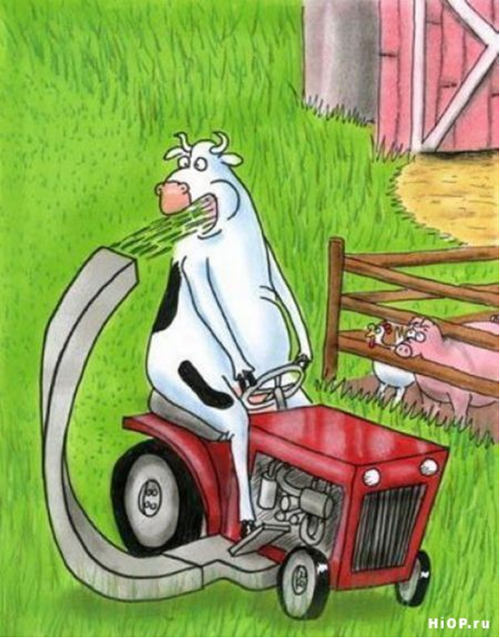
Livestock Impact
Cartoon by Dan Reynolds; used with permission. reynoldsunwrapped.weebly.com/
Slide Source:
Allen Williams

