Slide 1
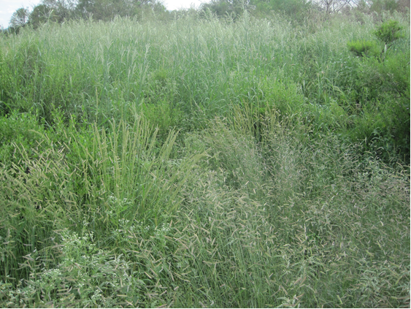
Las Damas Ranch
Slide Source:
Allen Williams

