Slide 1
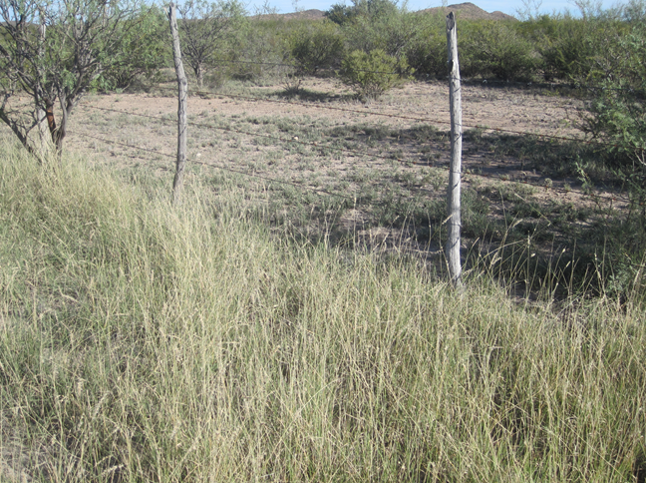
Neighbor’s Pasture
Las Damas Ranch
Slide Source:
Allen Williams

