Slide 1
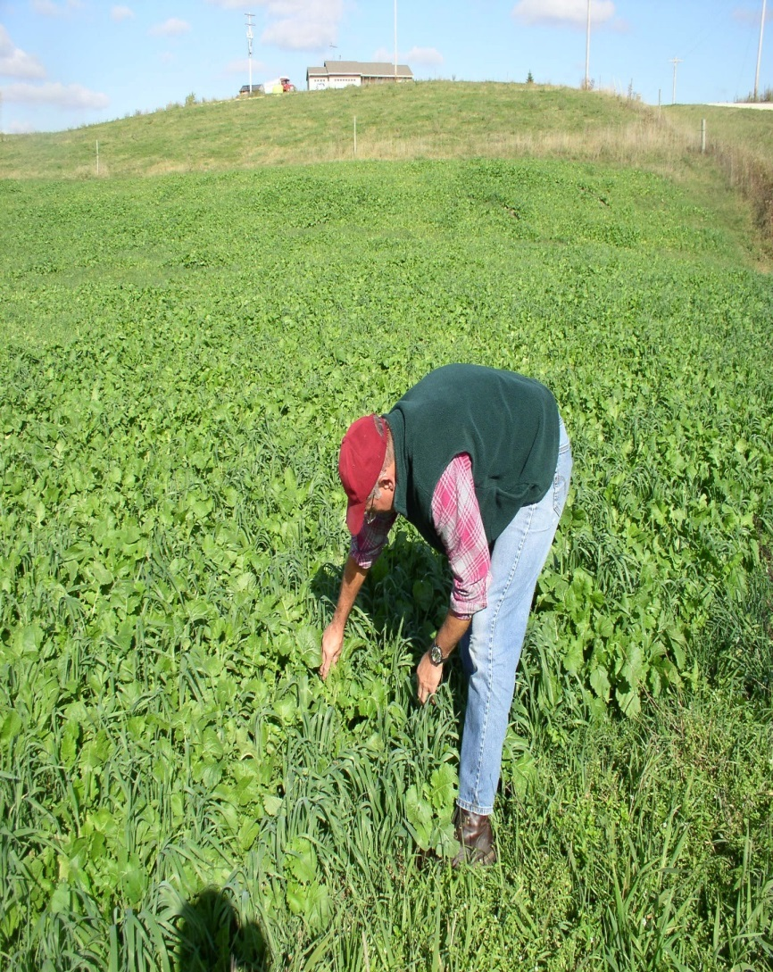
John Zinn
John Zinn has been a grazing specialist at USDA/NRCS for 11 years, serving first as a regional specialist in Northeast Minnesota and currently serving as State Grazing Specialist and Southeast Regional Specialist.
He works with farmers and ranchers providing technical assistance to help them meet their goals.
Prior to that he worked for the Vernon County Land Conservation Department and operated a rotational grazing based dairy farm near Westby, Wisconsin.

