Slide 1
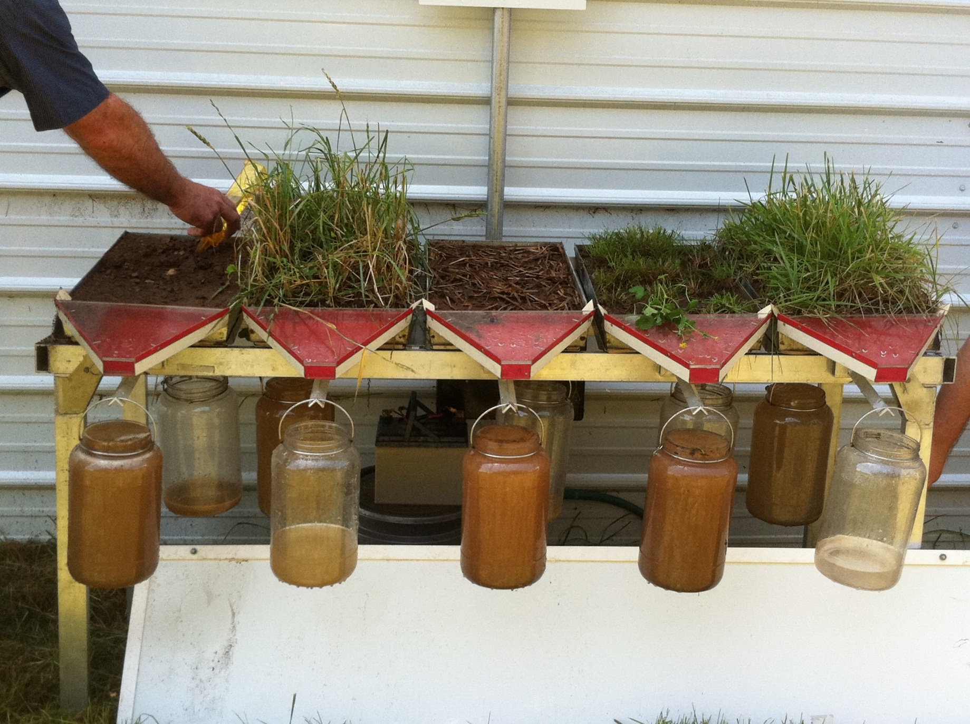
Improved Organic Matter = Reduced Runoff and Clean Water
Slide Source:
Allen Williams

