Slide 1
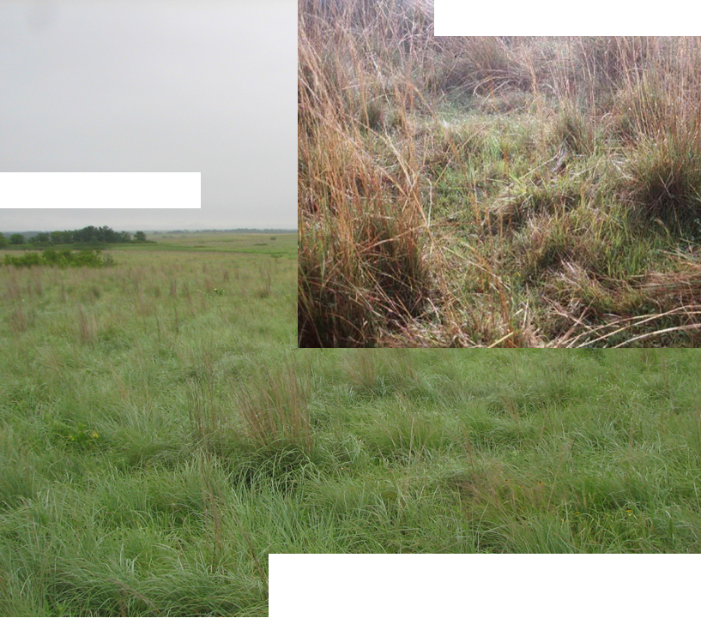
Light, Continous Graze
High Density Grazing
Teaugue, et al. 2013
Slide Source:
Allen Williams

