Slide 1
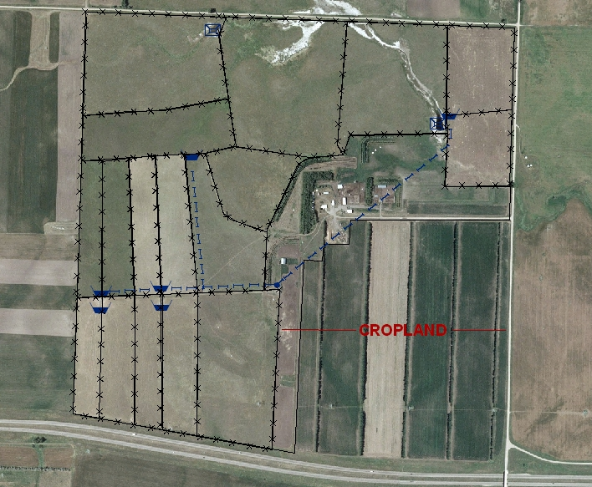
Have a Good Plan
Slide Source:
Allen Williams

